Slide 1
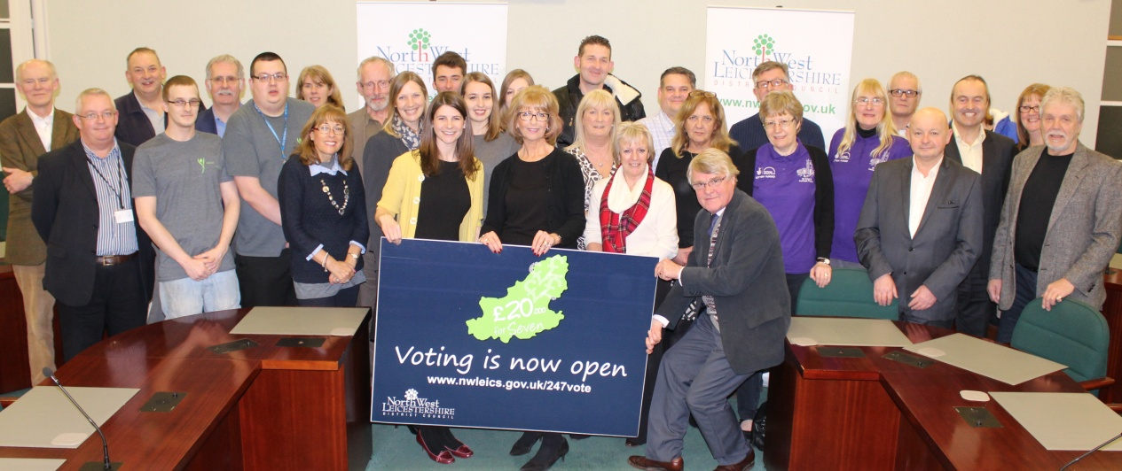
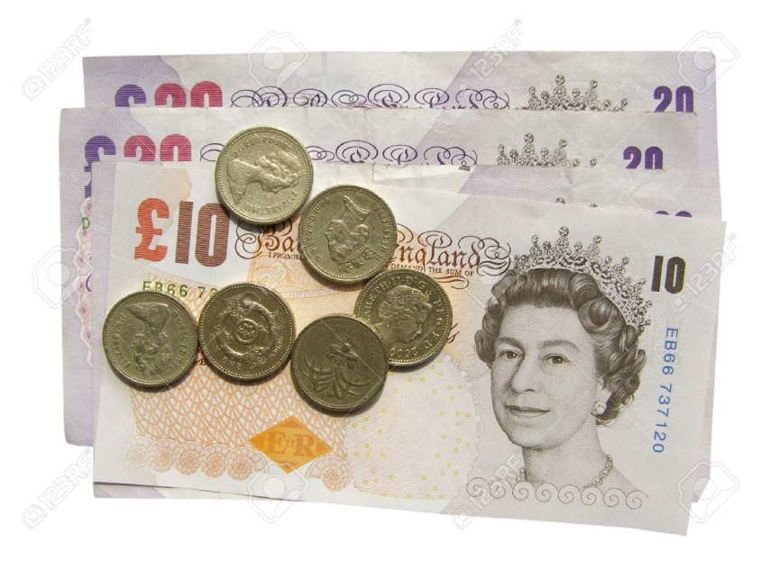
A year in the life of district, parish and town councils
January – New Year, New Projects
The grant provided to town and parish councils for 2016/17 totalled £100,000. Despite reductions in grants received by the district council from central government, these have not been passed on to the parish and town councils of North West Leicestershire.
12 community projects receive funding
£20,000 projects
Ashby Castle Lawn Tennis Club, Clubhouse extension
Castle Donington 3G multi use facility
The Storey Arms Community Pub in Osgathorpe
St Helens Community Heritage Centre and Churchyard in Ashby
£10,000 projects
Castle Donington Community Library
Growing Futures in Coleorton
LIGHTS,CAMERA,ACTION! Community Calls the Shots in Coalville
Top Rope Climbing Wall in Measham
React Upcycling in Coalville
Oakthorpe Centre Multi Media Room
Play for Snarestone!

Slide 2
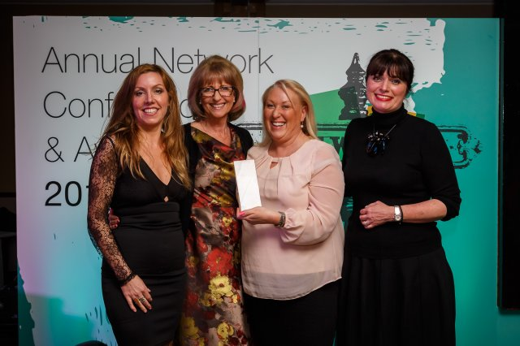
A year in the life of district, parish and town councils
February – NWL tackle dog fouling
NWLDC was the winner of the Keep Britain Tidy award for its Dog Watch Campaign. This was only achieved with the help of partners who enabled the pilot to be a success. A big ‘thank you’ to Measham Parish Council, Castle Donington Parish Council and Kegworth Parish Council

Slide 3
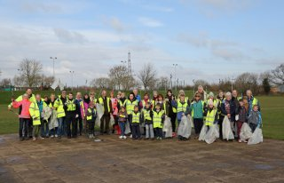
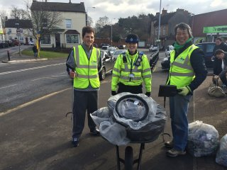
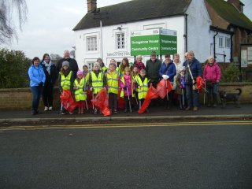
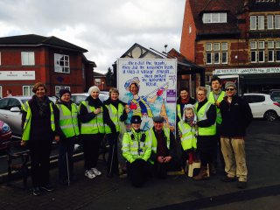
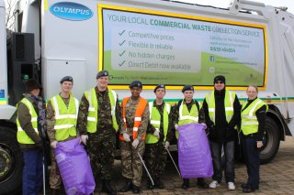
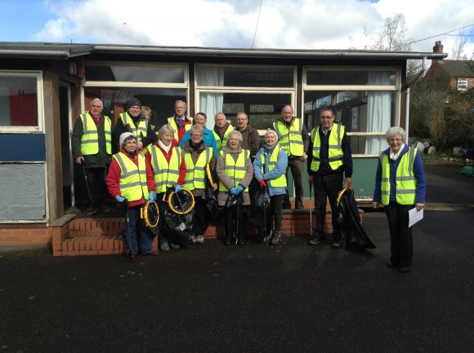
A year in the life of district, parish and town councils
March – A Right Royal Tidy Up

Slide 4
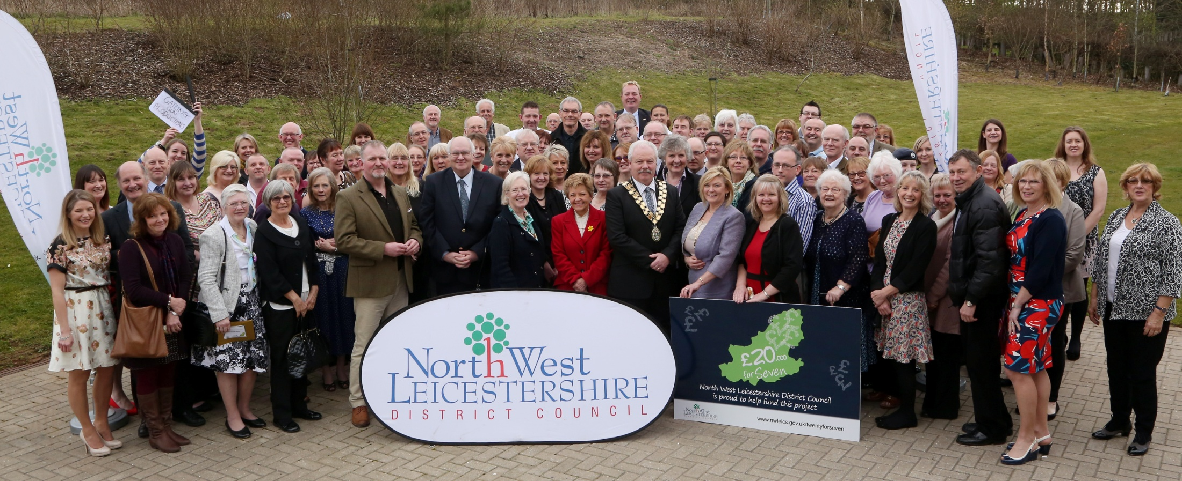
A year in the life of district, parish and town councils
March – Thanks and Celebrations
Over 100 volunteers from across the district were thanked for their hard work and commitment to making the communities of North West Leicestershire a place that people are proud of.
We also announced the two winners of the additional funding through the £20,000 for Seven Programme; Ashby Castle Lawn Tennis Club and MRC Community Action.

Slide 5
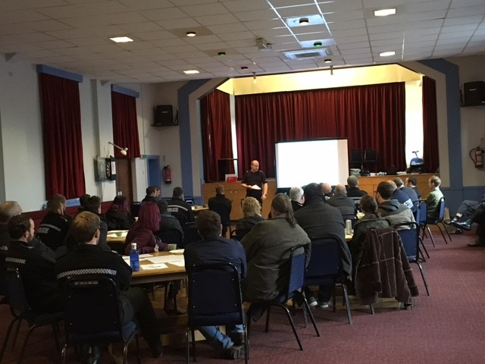
A year in the life of district, parish and town councils
April – Information is Key – Knowledge is Power
Information from town and parish councils helped us to develop a suite of training workshops over the year:
S106 and Community Infrastructure Levy training
Calling in Planning Applications
Gypsy and Traveller workshop - run by G.A.T.E at MRC Community Action
Licensing workshop
88 parish and town councillors have engaged in the training this year.

Slide 6
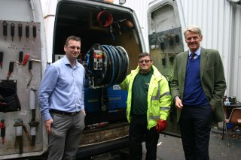
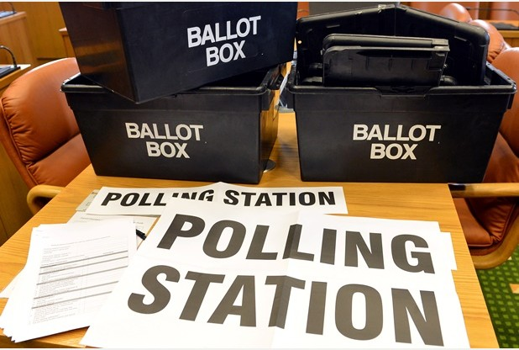
A year in the life of district, parish and town councils
May – Business As Usual
Police and Crime Commissioner Elections
Four candidates stood for election for the Leicestershire Police area
A total of 11,760 votes were cast in North West Leicestershire
Overall turnout for the whole of the Leicestershire Police area was 20.25%.
The turnout for North West Leicestershire was 16.04%
Duly Elected as the PCC for Leicestershire Police Area : BACH, Willy
Supporting the business community
13 small to medium sized businesses across the district have received grants to help grow their organisations and help take on 41 new employees.
Businesses such as Trunature Holdings in Measham, The Castle Inn in Castle Donington and Sapphire Products in Ashby.

Slide 7
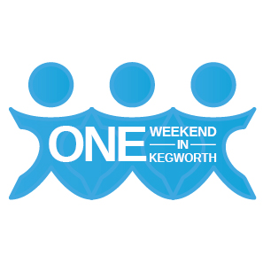
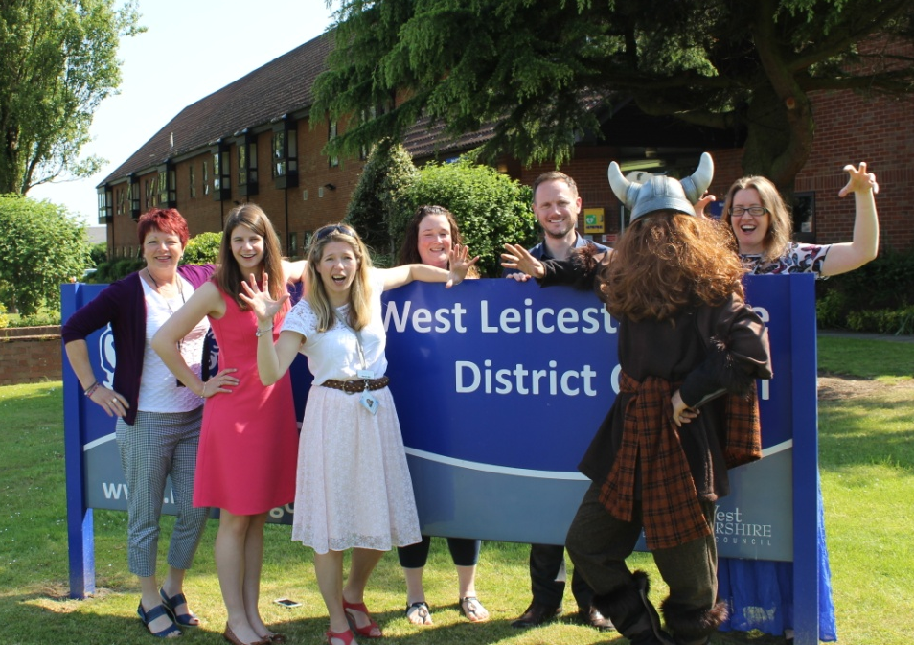
A year in the life of district, parish and town councils
June – From the EU Referendum to Events
Kegworth held their first ONE WEEKEND IN KEGWORTH event!
It was a huge success and they have secured just under £10,000 to be able to run the event again in 2017!
EU Referendum
The turnout in North West Leicestershire was 78% with 22,642 votes for Remain and 34,969 votes to Leave
27 ballot papers were rejected
Supported by town and parish councils through staff, venues or communication of election

Slide 8
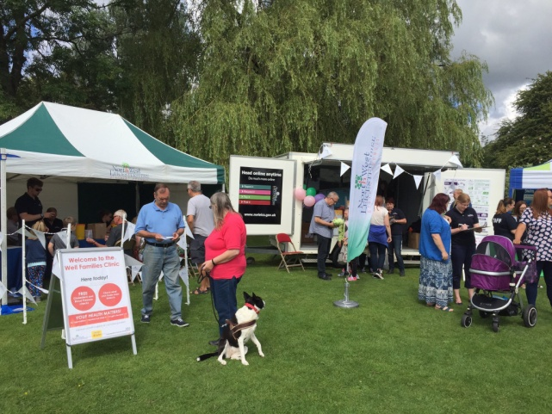
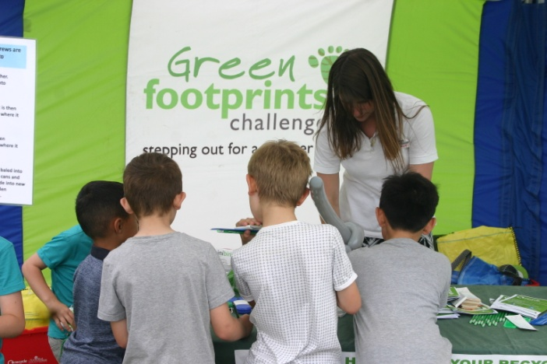
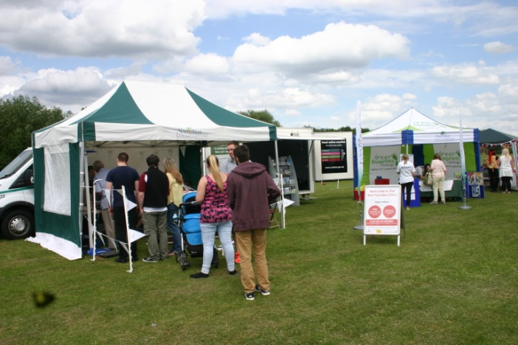
A year in the life of district, parish and town councils
July – out and about at community events
The district council trailer visited:
Picnic in the Park, Coalville
Music in the Park, Castle Donington
Jim’s Tractor Run, Ashby
Over 500 residents were engaged with at these events, with 213 people receiving a cholesterol and blood pressure test.

Slide 9
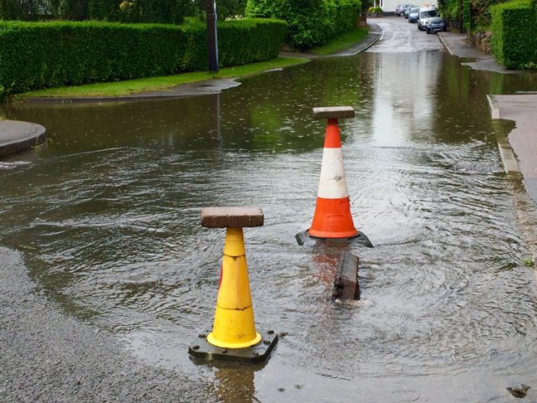
A year in the life of district, parish and town councils
August – Flood Forums
Flood Forums
In August North West Leicestershire District Council supported two flood forums looking how we can address any future risk. The two areas they were held in:
Breedon
Thringstone and Whitwick
A cleaner, safer and positive night time economy
North West Leicestershire District Council is working in partnership with Ashby de la Zouch Town Council and the night time economy in Ashby to apply for the Purple Flag status in January 2017. A perception survey was carried out in Ashby:
Total number of surveys = 382 with 95% of people feeling safe on a night out in Ashby.

Slide 10
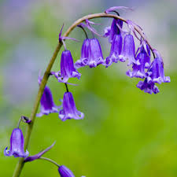
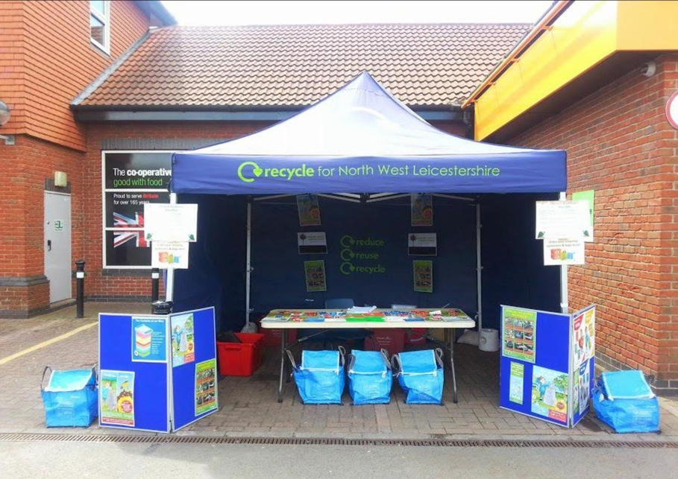
A year in the life of district, parish and town councils
September – Bulbalicious!
Everything came up smelling – not quite roses but definitely English bluebells, narcissi, daffodils and crocus. Our very popular ‘Green Shoots’ scheme saw us deliver a RECORD 38,500 spring flowering bulbs to 14 parish councils, schools and groups, ready for planting in October.
Throughout September our recycling roadshows visited: Ashby de la Zouch, Castle Donington and Coalville engaging with over 230 residents.

Slide 11
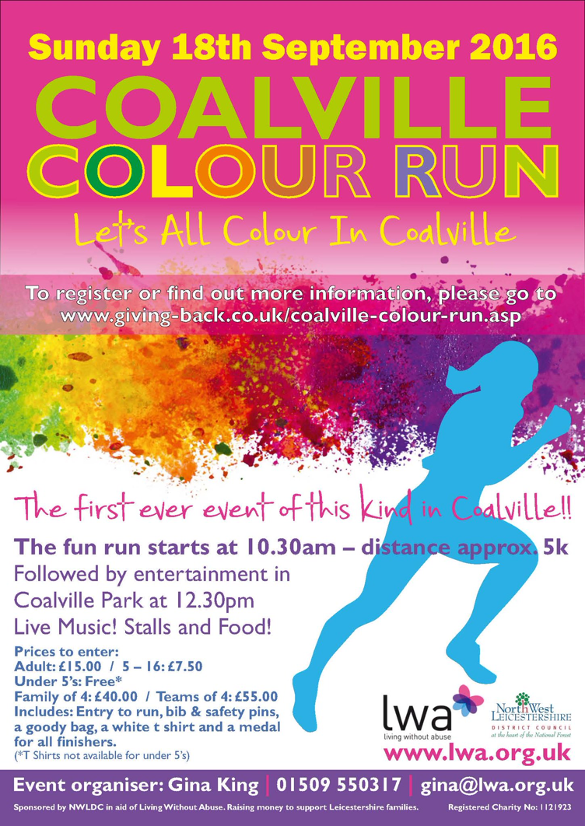
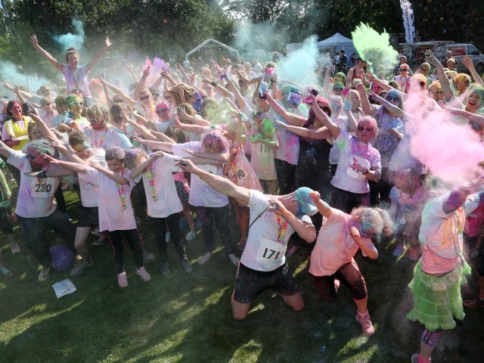
A year in the life of district, parish and town councils
September – Colour Run!
Coalville’s FIRST fun run event and FIRST Colour Run in North West Leicestershire.
500 runners took part in the event
The event raised £15,000 for Living Without Abuse charity)
Great community spirit!

Slide 12
A year in the life of district, parish and town councils
October – Grants, grants , grants!
Small Grants applications
Agar Nook Community Association
Castle Donington British Legion
Castle Donington Street Party Committee
Coleorton & New Lount Heritage Group
Diseworth Heritage Trust
Donisthorpe Community Fund
Hermitage FM
Ibstock Christmas Festival Committee
Coalville Special Expenses Community Chest applications
Without Walls Christian Fellowship
Ebenezer Baptist Church
Thringstone Retired People’s Fellowship
Green Grants applications
Trent Rivers Trust
Measham Parish Council
Castle Rock High School

Slide 13
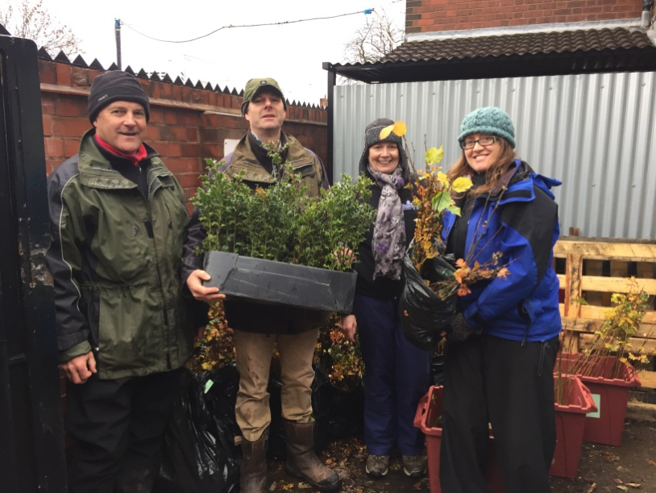
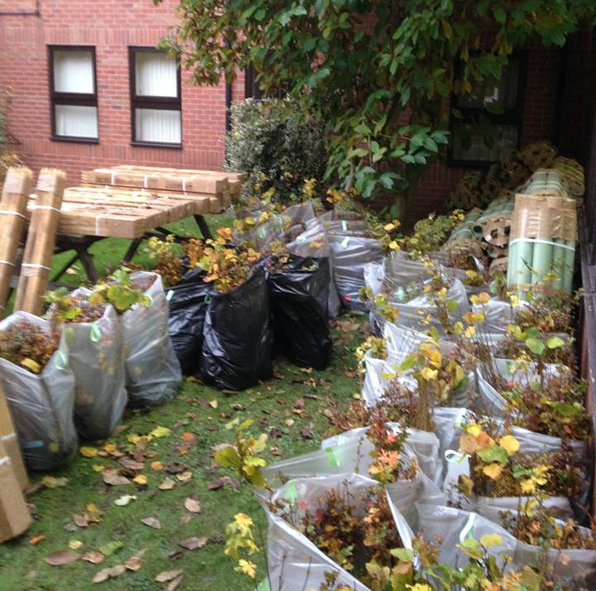
A year in the life of district, parish and town councils
November – Treemendous!
Over 14,500 trees were given away to residents across the district through the free tree and hedge fund scheme. Collections were arranged from Ashby de la Zouch, Coalville and Castle Donington.
This year the National Forest Company attended the free tree give away, handing out 32 resilience packs for planting!
Thank you to all the town and parish councils who have helped promote this year’s free tree scheme!

Slide 14
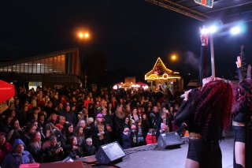
A year in the life of district, parish and town councils
December – Celebrating you!
4 Parish Liaisons
85% attendance
85% satisfaction
The Community Focus Team has been out and about having fun at your Christmas events throughout the district; spread good messages and good cheer!

