Slide 1

THE COMMUNITY HUB
7TH June 2017

Slide 2

What if your community had repeatedly asked for a “one stop shop”? A single place to access Council Information, Citizens’ Advice, Police Support, Transport for the Elderly & Disabled, Library Books etc

Slide 3
What if your community had repeatedly asked for a “one stop shop”? A single place to access Council Information, Citizens’ Advice, Police Support, Transport for the Elderly & Disabled, Library Books etc
What if you felt the only way the local Volunteer Centre and Library could remain viable in the long term was to pool resources and provide long term support?

Slide 4
What if your community had repeatedly asked for a “one stop shop”? A single place to access Council Information, Citizens’ Advice, Police Support, Transport for the Elderly & Disabled, Library Books etc
What if you felt the only way the local Volunteer Centre and Library could remain viable in the long term was to pool resources and provide long term support?
What if a choice of two suitable buildings became available, which maybe happens once in a generation, to re-house all these institutions in one place?

Slide 5
WHAT WOULD YOU DO?

Slide 6
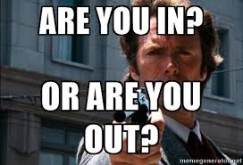
WHAT WOULD YOU DO?
?

Slide 7
AND THE TRUTH IS,

Slide 8

AND THE TRUTH IS, IT

Slide 9
BUT…..For a Parish Council?

Slide 10

BUT…..For a Parish Council?

Slide 11
Castle Donington Parish Council went for the “crazy” option!

Slide 12
Castle Donington Parish Council went for the “crazy” option!
However in its defence:

Slide 13
Castle Donington Parish Council went for the “crazy” option!
However in its defence:
2001 Community Appraisal

Slide 14
Castle Donington Parish Council went for the “crazy” option!
However in its defence:
2001 Community Appraisal
2008 Official Parish Plan

Slide 15
Castle Donington Parish Council went for the “crazy” option!
However in its defence:
2001 Community Appraisal
2008 Official Parish Plan
2013 Parish Plan update (Survey Monkey)…

Slide 16
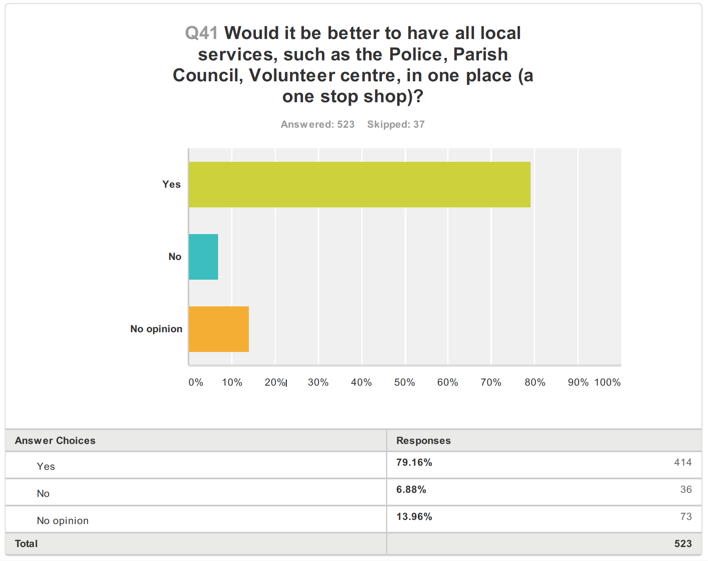

Slide 17
Castle Donington Parish Council went for the “crazy” option!
However in its defence - continued:

Slide 18
Castle Donington Parish Council went for the “crazy” option!
However in its defence - continued:
CDPC also knew that significant funds would become available specifically for “Community Projects”:

Slide 19
Castle Donington Parish Council went for the “crazy” option!
However in its defence - continued:
CDPC also knew that significant funds would become available specifically for “Community Projects”:
Roxhill - £100,000

Slide 20
Castle Donington Parish Council went for the “crazy” option!
However in its defence - continued:
CDPC also knew that significant funds would become available specifically for “Community Projects”:
Roxhill - £100,000
NWLDC - £100,000

Slide 21
Castle Donington Parish Council went for the “crazy” option!
However in its defence - continued:
CDPC also knew that significant funds would become available specifically for “Community Projects”:
Roxhill - £100,000
NWLDC - £100,000
Section 106 – 895 new housing development

Slide 22
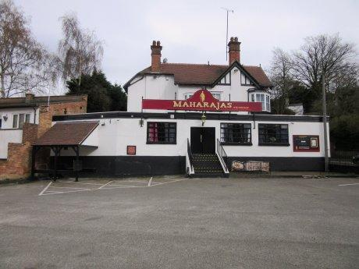
The Options:
Great Location
4,000 sq ft
Extra Parking (10 cars)

Slide 23
The Options:
Great Location
4,000 sq ft
Extra Parking (10 cars)
£750,000 asking price!!

Slide 24
The Options:
Great Location
4,000 sq ft
Extra Parking (10 cars)
£750,000 asking price!!
Recently purchased for £380,000 and valued at same

Slide 25
The Options:
Great Location
4,000 sq ft
Extra Parking (10 cars)
£750,000 asking price!!
Recently purchased for £380,000 and valued at same
Owners dropped the asking price to £550,000 but excluded the garages on Market Street

Slide 26
The Options:
NOT PURSUED
Great Location
4,000 sq ft
Extra Parking (10 cars)
£750,000 asking price!!
Recently purchased for £380,000 and valued at same
Owners dropped the asking price to £550,000 but excluded the garages on Market Street

Slide 27
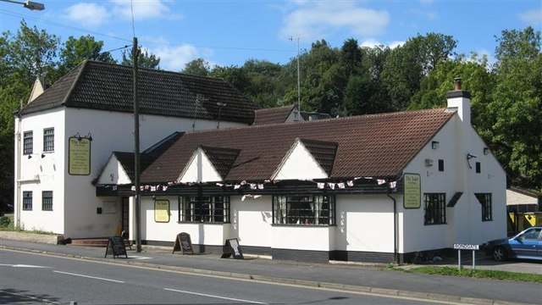
The Options:
Good Location
6,600 sq ft
Extra Parking (45 cars)

Slide 28
The Options:
Good Location
6,600 sq ft
Extra Parking (45 cars)
Asking price reduced to £650,000

Slide 29
The Options:
Good Location
6,600 sq ft
Extra Parking (45 cars)
Asking price reduced to £650,000
Owners liked Community Hub idea

Slide 30
The Options:
Good Location
6,600 sq ft
Extra Parking (45 cars)
Asking price reduced to £650,000
Owners liked Community Hub idea
Sale price of £570,000 agreed!

Slide 31

The Options:
Good Location
6,600 sq ft
Extra Parking (45 cars)
Asking price reduced to £650,000
Owners liked Community Hub idea
Sale price of £570,000 agreed!

Slide 32

The Options:
Good Location
6,600 sq ft
Extra Parking (45 cars)
Asking price reduced to £650,000
Owners liked Community Hub idea
Sale price of £570,000 agreed!

Slide 33
The Finance:
Aim - keep the mortgage payments minimal

Slide 34
The Finance:
Aim - keep the mortgage payments minimal
Short term borrow - Section 106 Recreation money

Slide 35
The Finance:
Aim - keep the mortgage payments minimal
Short term borrow - Section 106 Recreation money
NWLDC Support – Public Works Loans Board

Slide 36
The Finance:
Aim - keep the mortgage payments minimal
Short term borrow - Section 106 Recreation money
NWLDC Support – Public Works Loans Board
Sought approval for £750,000 – approved in principle

Slide 37
The Finance:
Aim - keep the mortgage payments minimal
Short term borrow - Section 106 Recreation money
NWLDC Support – Public Works Loans Board
Sought approval for £750,000 – approved in principle
Eventually needed £400,000 => ~£21,000 pa

Slide 38
The Finance:
Aim - keep the mortgage payments minimal
Short term borrow - Section 106 Recreation money
NWLDC Support – Public Works Loans Board
Sought approval for £750,000 – approved in principle
Eventually needed £400,000 => ~£21,000 pa
Paid for, in part, by a £5 increase in precept => ~£12,500 pa

Slide 39
The Finance:
Aim - keep the mortgage payments minimal
Short term borrow - Section 106 Recreation money
NWLDC Support – Public Works Loans Board
Sought approval for £750,000 – approved in principle
Eventually needed £400,000 => ~£21,000 pa
Paid for, in part, by a £5 increase in precept => ~£12,500 pa
PWLB said CDPC needed a mandate from electorate - quickly!

Slide 40
The Finance:
Aim - keep the mortgage payments minimal
Short term borrow - Section 106 Recreation money
NWLDC Support – Public Works Loans Board
Sought approval for £750,000 – approved in principle
Eventually needed £400,000 => ~£21,000 pa
Paid for, in part, by a £5 increase in precept => ~£12,500 pa
PWLB said CDPC needed a mandate from electorate - quickly!
PWLB approved Music In The Park event – 3,000 attendees

Slide 41
The Finance:
Aim - keep the mortgage payments minimal
Short term borrow - Section 106 Recreation money
NWLDC Support – Public Works Loans Board
Sought approval for £750,000 – approved in principle
Eventually needed £400,000 => ~£21,000 pa
Paid for, in part, by a £5 increase in precept => ~£12,500 pa
PWLB said CDPC needed a mandate from electorate - quickly!
PWLB approved Music In The Park event – 3,000 attendees
~ 800 votes cast – 98% said “YES”

Slide 42
15th November 2016 – CDPC finally became the owner of the building:

Slide 43
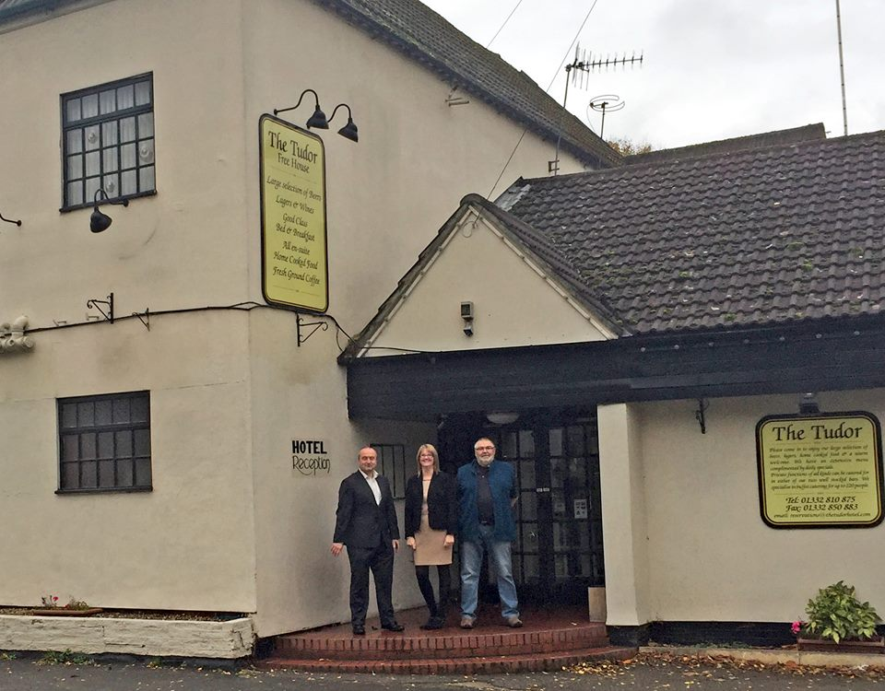
15th November 2016 – CDPC finally became the owner of the building:

Slide 44
15th November 2016 – CDPC finally became the owner of the building:
The
Community
Hub

Slide 45
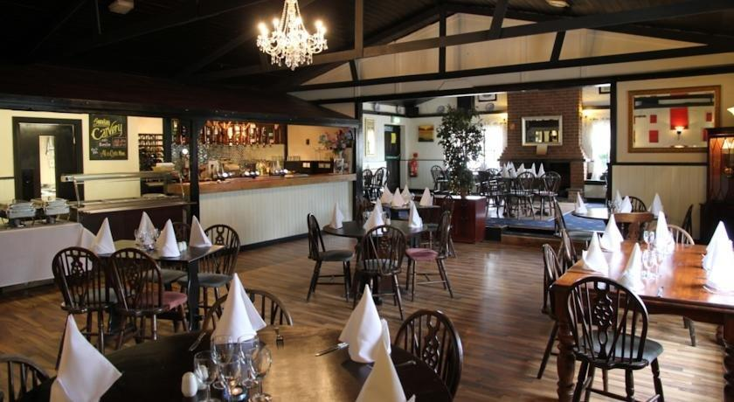
The Restaurant: The furniture had already gone

Slide 46
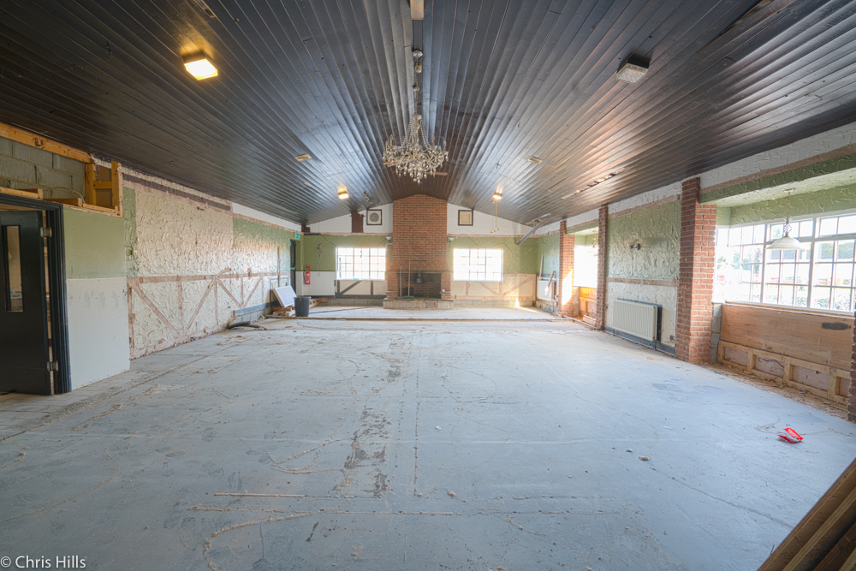
Then fixtures cleared - restaurant will be the function room

Slide 47
Initial Tenants

Slide 48
Initial Tenants – Peppercorn Rent

Slide 49

Initial Tenants – Peppercorn Rent

Slide 50
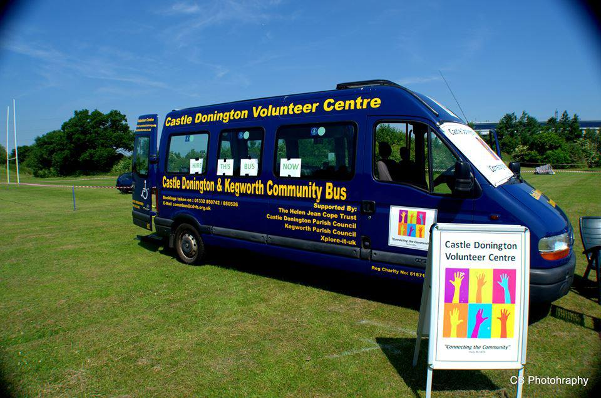
Initial Tenants – Peppercorn Rent

Slide 51
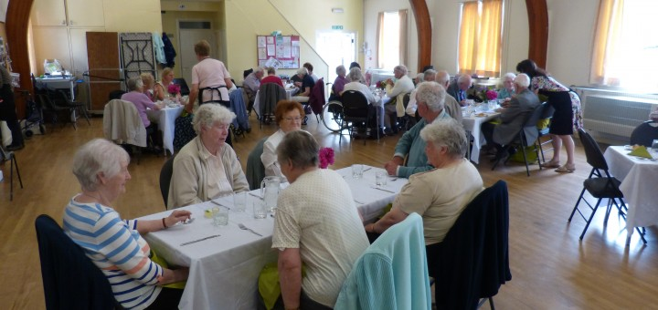
Initial Tenants – Peppercorn Rent

Slide 52
Initial Tenants – Peppercorn Rent

Slide 53

Initial Tenants – Peppercorn Rent

Slide 54
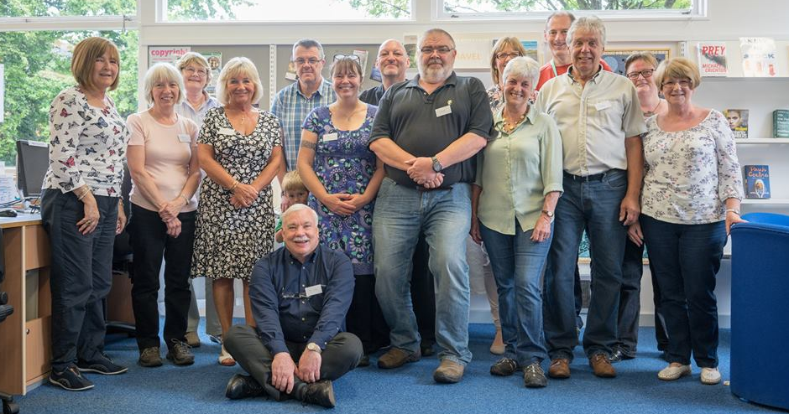
Initial Tenants – Peppercorn Rent

Slide 55
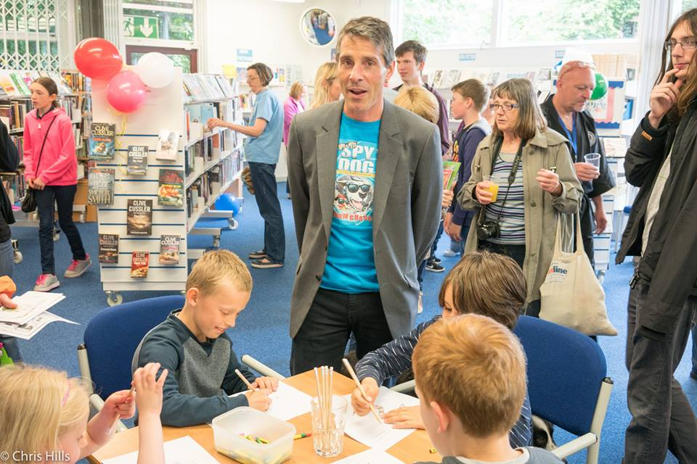
Initial Tenants – Peppercorn Rent

Slide 56

Initial Tenants – Peppercorn Rent

Slide 57
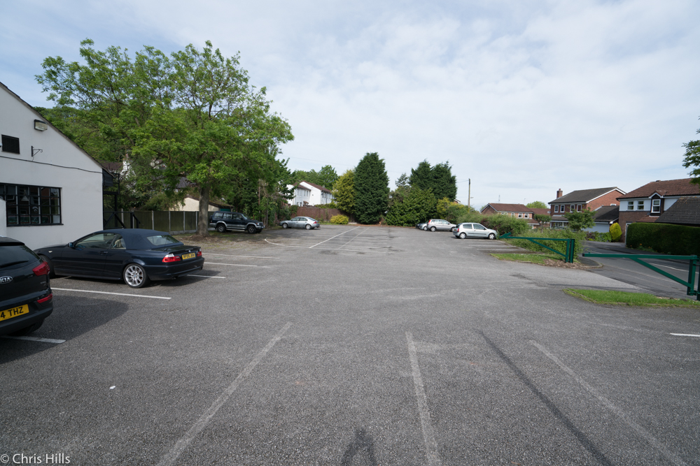
Initial Tenants – Peppercorn Rent

Slide 58
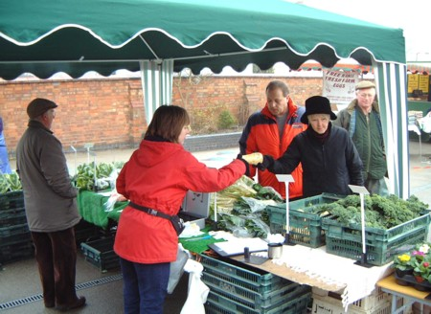
Initial Tenants – Peppercorn Rent

Slide 60
Proposed Ground Floor

Slide 64

Additional Challenges:
Full traffic impact report
Archaeological Survey

Slide 65
Additional Challenges:
Full traffic impact report
Negotiated away
Archaeological Survey

Slide 66
Additional Challenges:
Full traffic impact report
Negotiated away
Archaeological Survey
£1,200 & 5 week delay

Slide 67
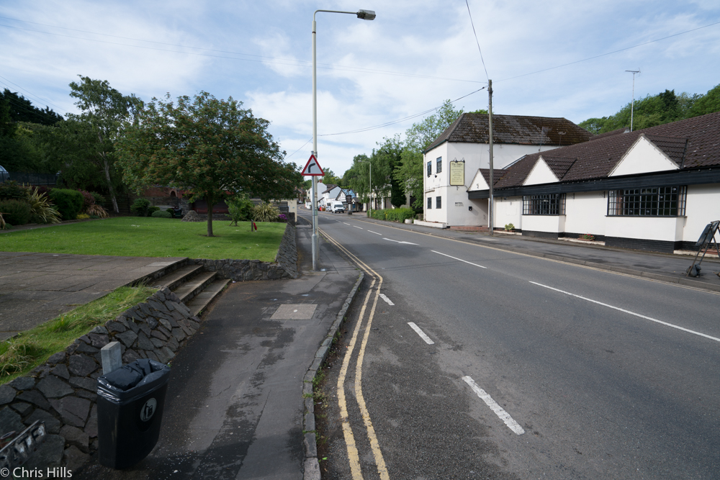
Additional Challenges:
Full traffic impact report
Negotiated away
Archaeological Survey
£1,200 & 5 week delay
Unspent Section 106
£250,000 - bus station/crossroads improvement

Slide 68
Additional Challenges:
Full traffic impact report
Negotiated away
Archaeological Survey
£1,200 & 5 week delay
Unspent Section 106
£250,000 - bus station/crossroads improvement
Instead create a crossing here?

Slide 69
Additional Challenges:
Full traffic impact report
Negotiated away
Archaeological Survey
£1,200 & 5 week delay
Unspent Section 106
£250,000 - bus station/crossroads improvement
Instead create a crossing here?

Slide 70
Additional Challenges:
Full traffic impact report
Negotiated away
Archaeological Survey
£1,200 & 5 week delay
Unspent Section 106
£250,000 - bus station/crossroads improvement
Instead create a crossing here?
Traffic calming?

Slide 73


Slide 75


Slide 76


Slide 78


Slide 79


Slide 80


Slide 81
GrowCookShare After School Films Theatre Presentations etc

Slide 82
CASTLE DONINGTON
COMMUNITY
HUB
GrowCookShare After School Films Theatre Presentations etc

Slide 83
THE COMMUNITY HUB
THANK YOU

