Slide 1


COALVILLE COMMEMORATES

Slide 2
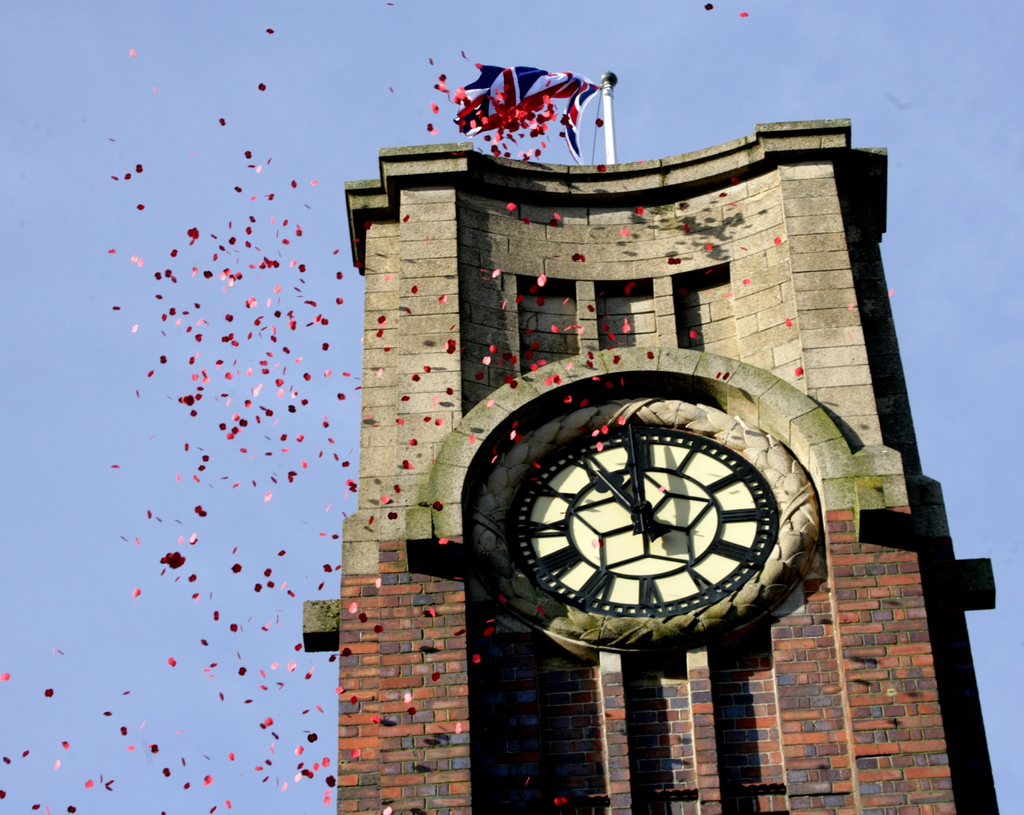
Coalville Commemorates
50 weeks|50 stories
One-Day Community Play
Commemorative Trail
Memorial Square Poppy Mosaic
Remembrance Service and Parade
North West Leicestershire Commemorates
working with town/parish councils and communities to commemorate in 2018.
Coalville Remembers
A film created in partnership between North West Leicestershire District Council and Century of Stories. Footage taken at the 2016 Remembrance Sunday service and parade in Coalville.
Web link below, watch in Google Chrome
https://www.youtube.com/watch?v=oJHa-IPxO-8&feature=player_embedded

Slide 3
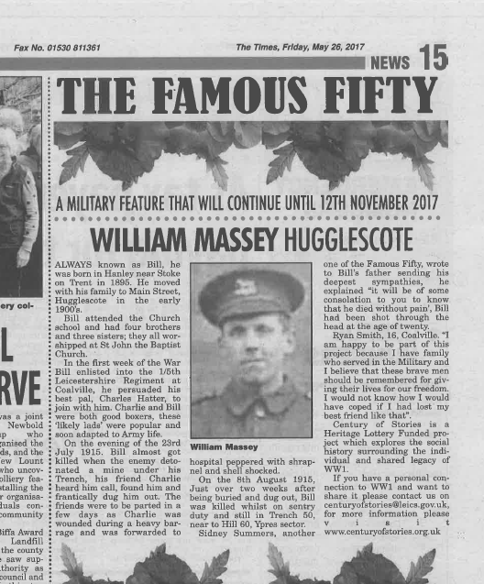
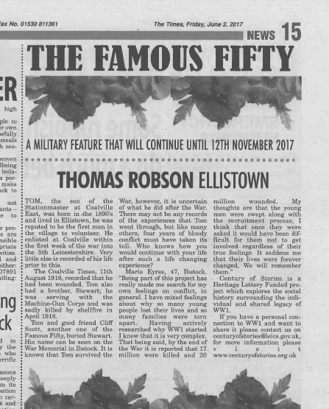
50 weeks | 50 stories
Coalville Times Feature:
Opportunities: Telling the story of the stories
Raise the profile of these stories, and carry them on a dedicated tab in Choose Coalville website

Slide 4

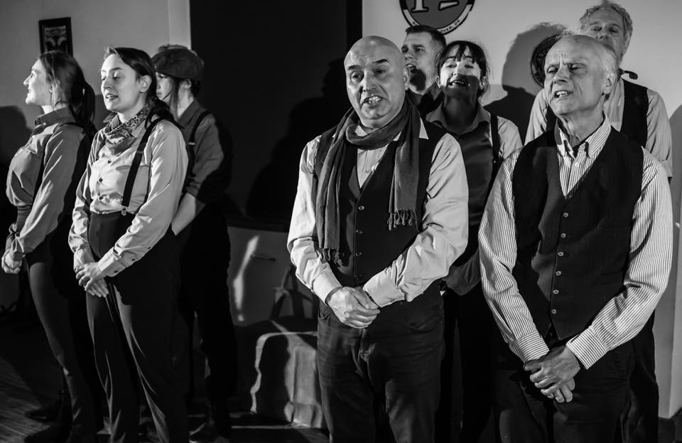

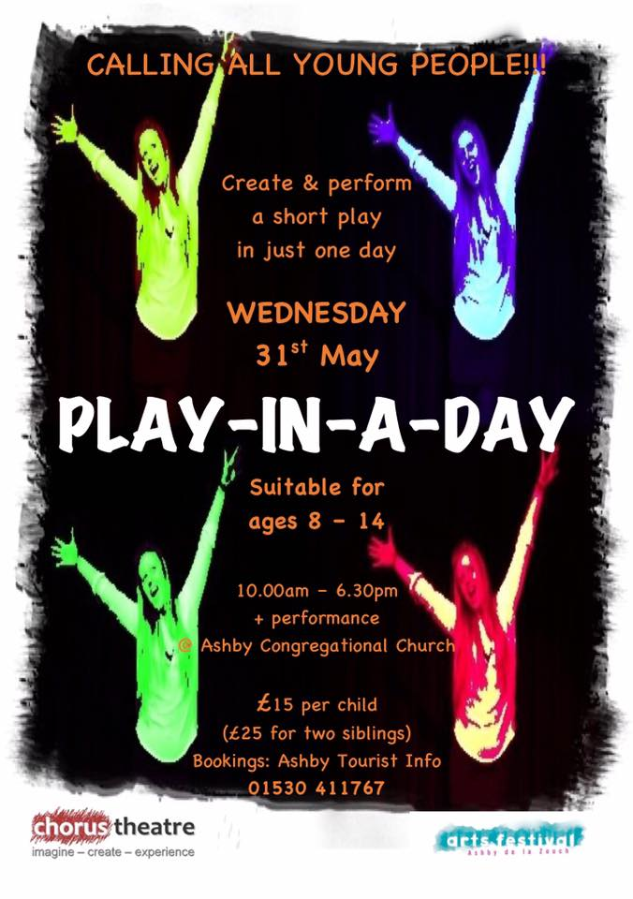
One Day Community Play – 14 October 2017
To commemorate the soldier stories (Famous 50) from the Coalville area with a participatory community performance project in the autumn of 2017.
To actively engage members of the local community in a creative heritage project.

Slide 5
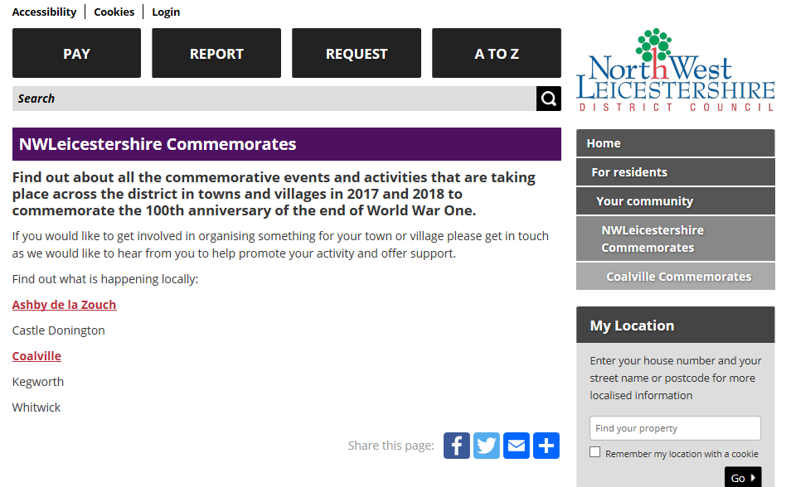

North West Leicestershire Commemorates
www.nwleics.gov.uk

Slide 6
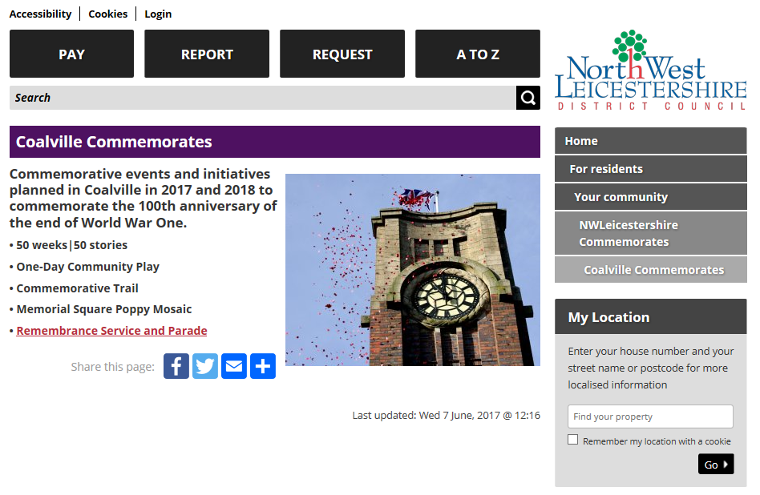
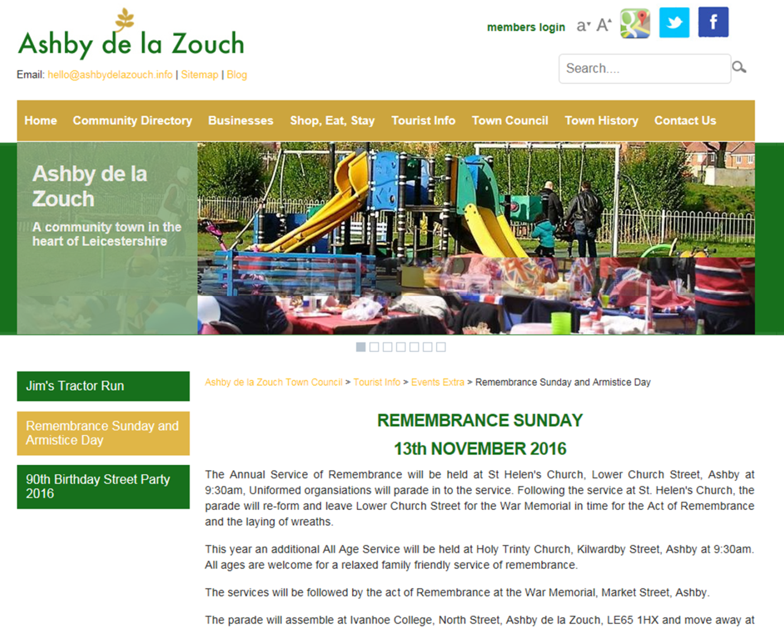

Slide 7
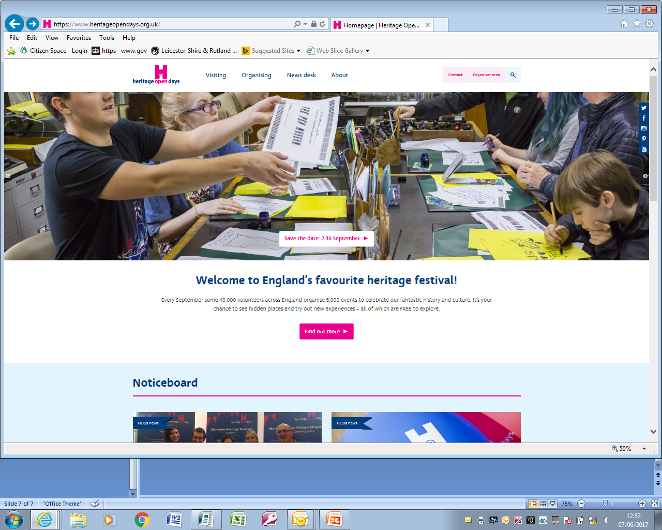
North West Leicestershire Heritage Festival
https://www.heritageopendays.org.uk/
7 – 10 September 2017
North West Leicestershire
Heritage Festival
1 – 17 September 2017
encourage local organisations to celebrate heritage
local promotion
funding (small grant scheme)
link in with heritage open days
www.nwleics.gov.uk

Slide 8
Cultural Services
Wendy May – 01530 454769
wendy.may@nwleicestershire.gov.uk
www.nwleics.gov.uk

