Slide 1
www.nwleics.gov.uk
Developing a Health and Wellbeing Strategy for North West Leicestershire

Slide 2
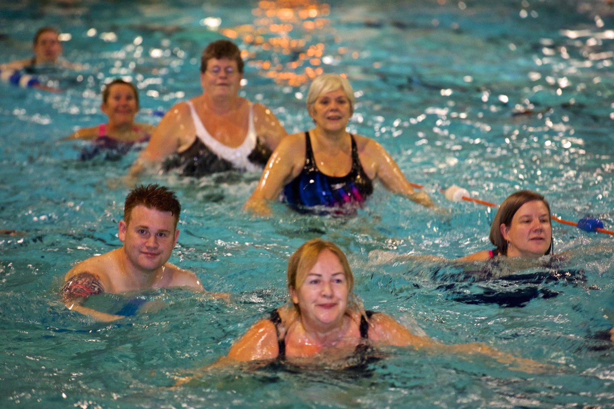
Introduction
NWLDC has commissioned Knight, Kavanagh and Page Ltd (KKP) to produce a Health and Wellbeing Strategy
The strategy will set out a long term (10 year) vision and priorities
It will include specific objectives for the next five years
It will show how the various agencies will contribute to, support, promote and deliver the objectives of the strategy
It will inform the work of a range of council departments and partner agencies.

Slide 3
Linking to the Sport and Leisure Project
The Health and Wellbeing Strategy is being produced in tandem with the Sport and Leisure Project
Bidders for the contract are being asked how they will improve health, wellbeing, social and community outcomes in the district
The successful provider will need to demonstrate how they are performing against our health and well-being strategy

Slide 4
Timescales
The strategy will take 6 – 8 months to develop. We hope it will be in place by the end of 2018
1. Research
Existing policies (NWLDC)
Existing policies (partners)
Demographic review
Data review (e.g. sports facility users, housing)
2. Initial consultation
Council officers
Members
Public Health
Leicestershire County Council
Leicestershire & Rutland Sport
Sport England
Local Strategic Partnership
NWL Staying Healthy Partnership
Parish and town councils
Others (as agreed)
3. Interim outline strategy
Showing key potential strategy issues including trends, interdependencies, assets, workforce, existing programmes, provision for target groups
4. Wider consultation
To discuss key issues, the proposed vision and objectives, the roles of NWLDC and partners, facility use and health and wellbeing provision
5. Draft strategy
The draft strategy is drawn up and shared with the Steering Group and any additional comments are received
6. Final strategy
Production and adoption
Executive summary
First period action plan
Linked to monitoring and evaluation framework

Slide 5
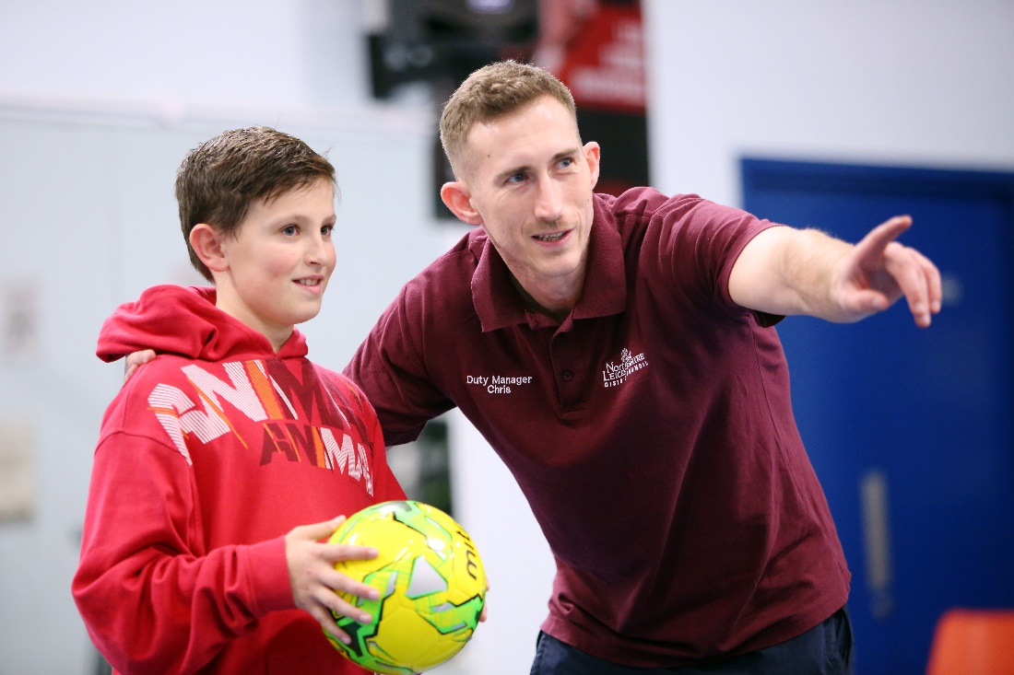
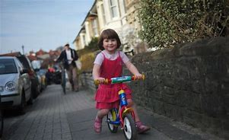
NWLDC’s role
Several district council services have a direct impact on public health and wellbeing:
Housing
Leisure and green spaces
Active travel
Environmental health
District councils are also in a good position to influence and affect health and wellbeing outcomes through partnership working

Slide 6
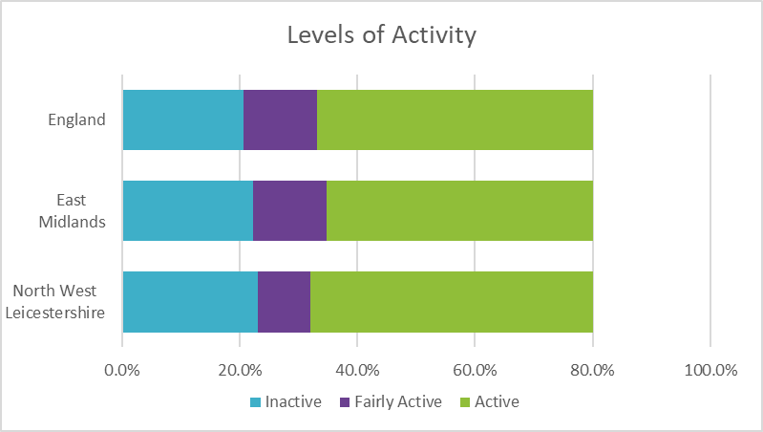
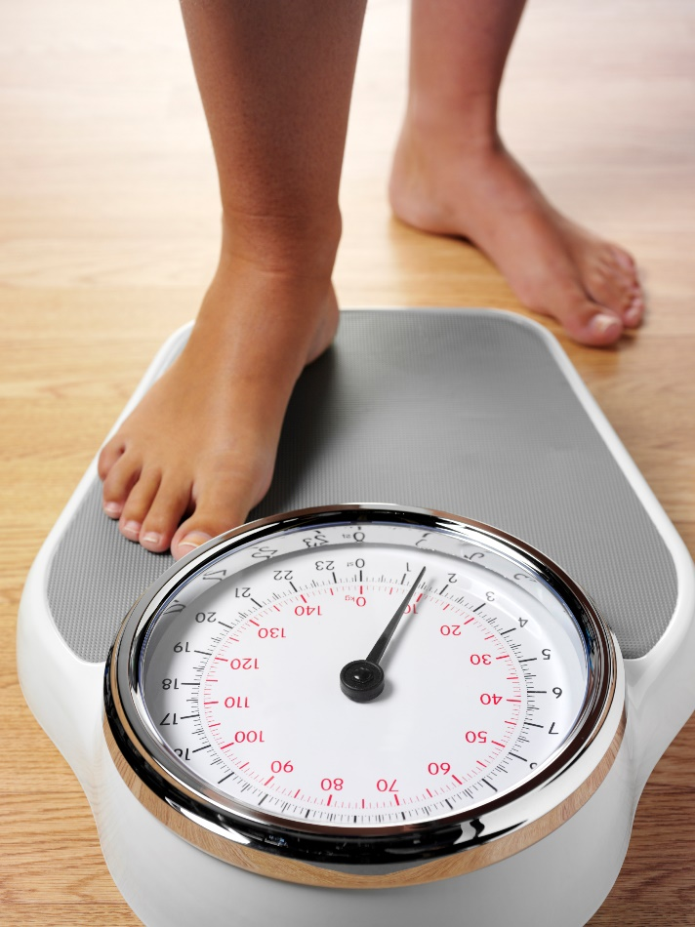
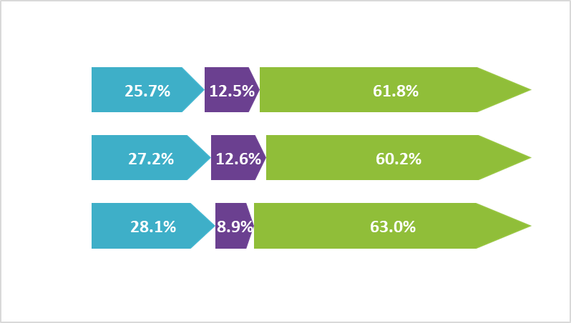
Initial findings
North West Leicestershire has both:
Higher levels of physical inactivity
Higher levels of physical activity
This refers to exercising three or more times per week

Slide 7
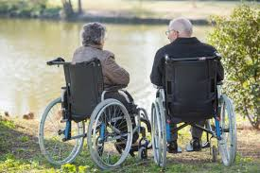
Initial findings
In North West Leicestershire:
Adult obesity (29.1%) is above the national (24.0%) and regional (25.5%) average
Child obesity rates are slightly below the national average
Age profile – 65+ increases from c.18.5k to 24.5k in 2027
The most popular sports are cycling, gym and swimming
People have busy lifestyles with high levels of employment
Transport is an issue, which can add to elevated levels of rural and social isolation.

Slide 8
Your involvement
This is the first stage of writing the strategy, so it’s the first opportunity for you to guide its development.
Q. What do you think are the key health and well-being issues that the strategy should address?
Why?
Q. How can we monitor progress?

Slide 9
Questions
Please ask any questions you may have

