Slide 1
High Speed 2 - Phase 2B: Towards a Hybrid Bill
November 2016
Notes:
Welcome delegates,
Health and safety notice,
introduction of HS2 colleagues.

Slide 2
This afternoon
Outline the programme
Overview of timescales
Run through the route and consultations
Discuss local issues and questions

Slide 3
Strategic Context
Announcement by Secretary of State signals Government commitment
Confirmed proposals for both legs of Phase 2b
7 major route refinements being consulted on
Property schemes consultation also announced

Slide 4
Strategic context
Give certainty for developing regeneration and development planning
Helps business with confidence to make decisions
Helps take forward transport planning for the future
Releases further Growth Funding

Slide 5
Strategic Context
Includes considerations from 2013 consultation
Sir David Higgins further reports
Emerging devolution
Work with Transport for the North/Dft/Network Rail
Integrated Network/Midlands Connect
Links to Scotland
Strategic Planning with HE and NR

Slide 6
Route announcement – 15 November
Confirmation of the majority of the Phase 2b route
Launch of two consultations:
A consultation on route refinements
A consultation on property schemes
Issued Safeguarding Directions
Need to Sell scheme now available, replaces Exceptional Hardship Scheme

Slide 7
Safeguarding and discretionary compensation schemes

Slide 8
Safeguarding
Planning tool to protect land to ensure that new developments do not affect the ability to build or operate HS2 or lead to excessive additional costs.
The Secretary of State for Transport issues directions under the Town and Country Planning Act 1990 – it is a statutory instrument.

Slide 9
Safeguarding: who does it affect?
Local Planning Authorities (LPAs)
LPAs need to consult HS2 Ltd with regard to any planning applications falling within the SG zone
LPAs need to inform property buyers about HS2 when searches are undertaken
Land and property owners
Affected property owners are able to serve a ‘blight notice’, asking the government to buy their property early (i.e. in advance of any compulsory purchase)
Notes:
Safeguarding – planning applications
Once safeguarding directions are issued by the Secretary of State, local authorities are required to consult HS2 Ltd on planning applications within the safeguarded area.
Guidance for local authorities will accompany the issue of the safeguarding directions.
Consultations should be sent to a dedicated email address – town.planning@hs2.org.uk
HS2 Ltd will work with local authorities and developers to understand any potential conflicts with the railway.
Prior to announcement any questions on the general safeguarding process can be sent to town.planning@hs2.org.uk, and the town planning team can meet with local authorities’ development management teams if needed once the safeguarding directions have been issued.

Slide 10
Safeguarding principles
Default distance for boundary and general principles:
A 120m surface safeguarding zone to be established across the route where there is standard track separation (5m) and the HS2 alignment does not run parallel to the classic network
Distance can be varied where appropriate to reflect the needs of the railway. Therefore, i) standard 60m corridor; or ii) existing buffer, e.g. motorway, railway; or iii) engineering judgement
Where it is likely that additional tracks will be necessary alongside the standard two tracks, additional land will be included to allow for this, to be agreed with engineers;

Slide 11
Discretionary Property Schemes (Phase 2A)
Notes:
Phase 2A example property schemes
Phase 2B schemes subject to consultation and SoS decision (this diagram will be the starting point)

Slide 12
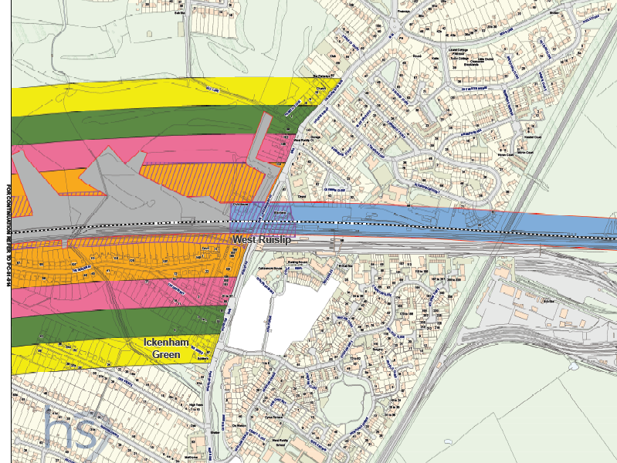
Notes:
Example from Phase 1 safeguarding and discretionary schemes
Key:
Grey zone: Safeguarded area
Homeowner Payments are only available in rural areas.
Orange: Rural Support Zone
Pink: Homeowner protection zone 1 (£22,500)
Green: Homeowner protection zone 2 (£15,000)
Yellow: Home owner protection zone 3 (£7,500)
All property related matters (i.e. what is determined to be a rural area, the payments available etc) will be consulted on following route announcement.

Slide 13
Next Steps
Consultations (Property / Route refinement)
Data gathering for EIA (Inc. Transport Assessments )
Community engagement
Priority surveys

Slide 14
The route in your area
Notes:
Use as appropriate

Slide 15
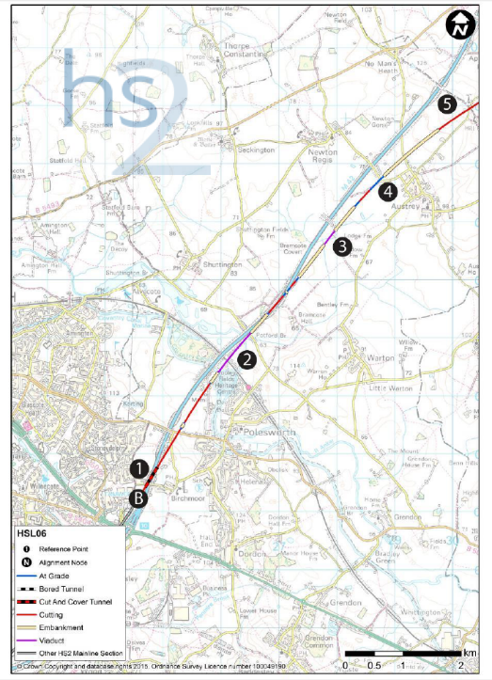
Birchmoor (B) to Appleby Parva
1 – Green Lane
2 – West Coast Main Line
railway
3 – Bramcote Brook
4 – Austrey
5 – Appleby Hill

Slide 16
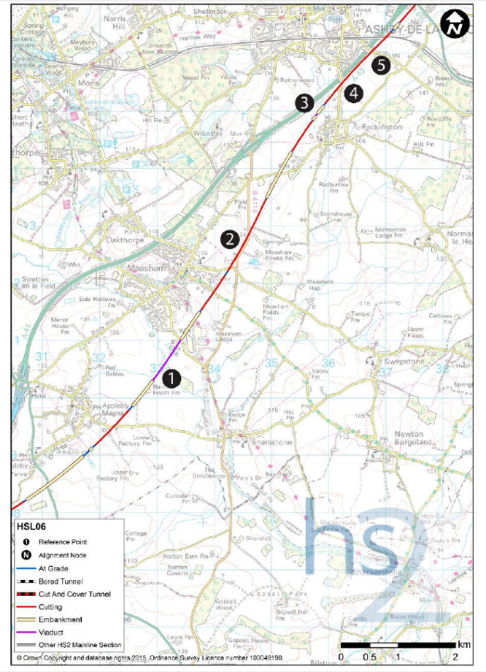
Appleby Parva to Ashby-de-la-Zouch
1 – River Mease
2 – B4116
3 – Gilwiskaw Brook
4 – Ashby Road
5 – Leicester Road

Slide 17
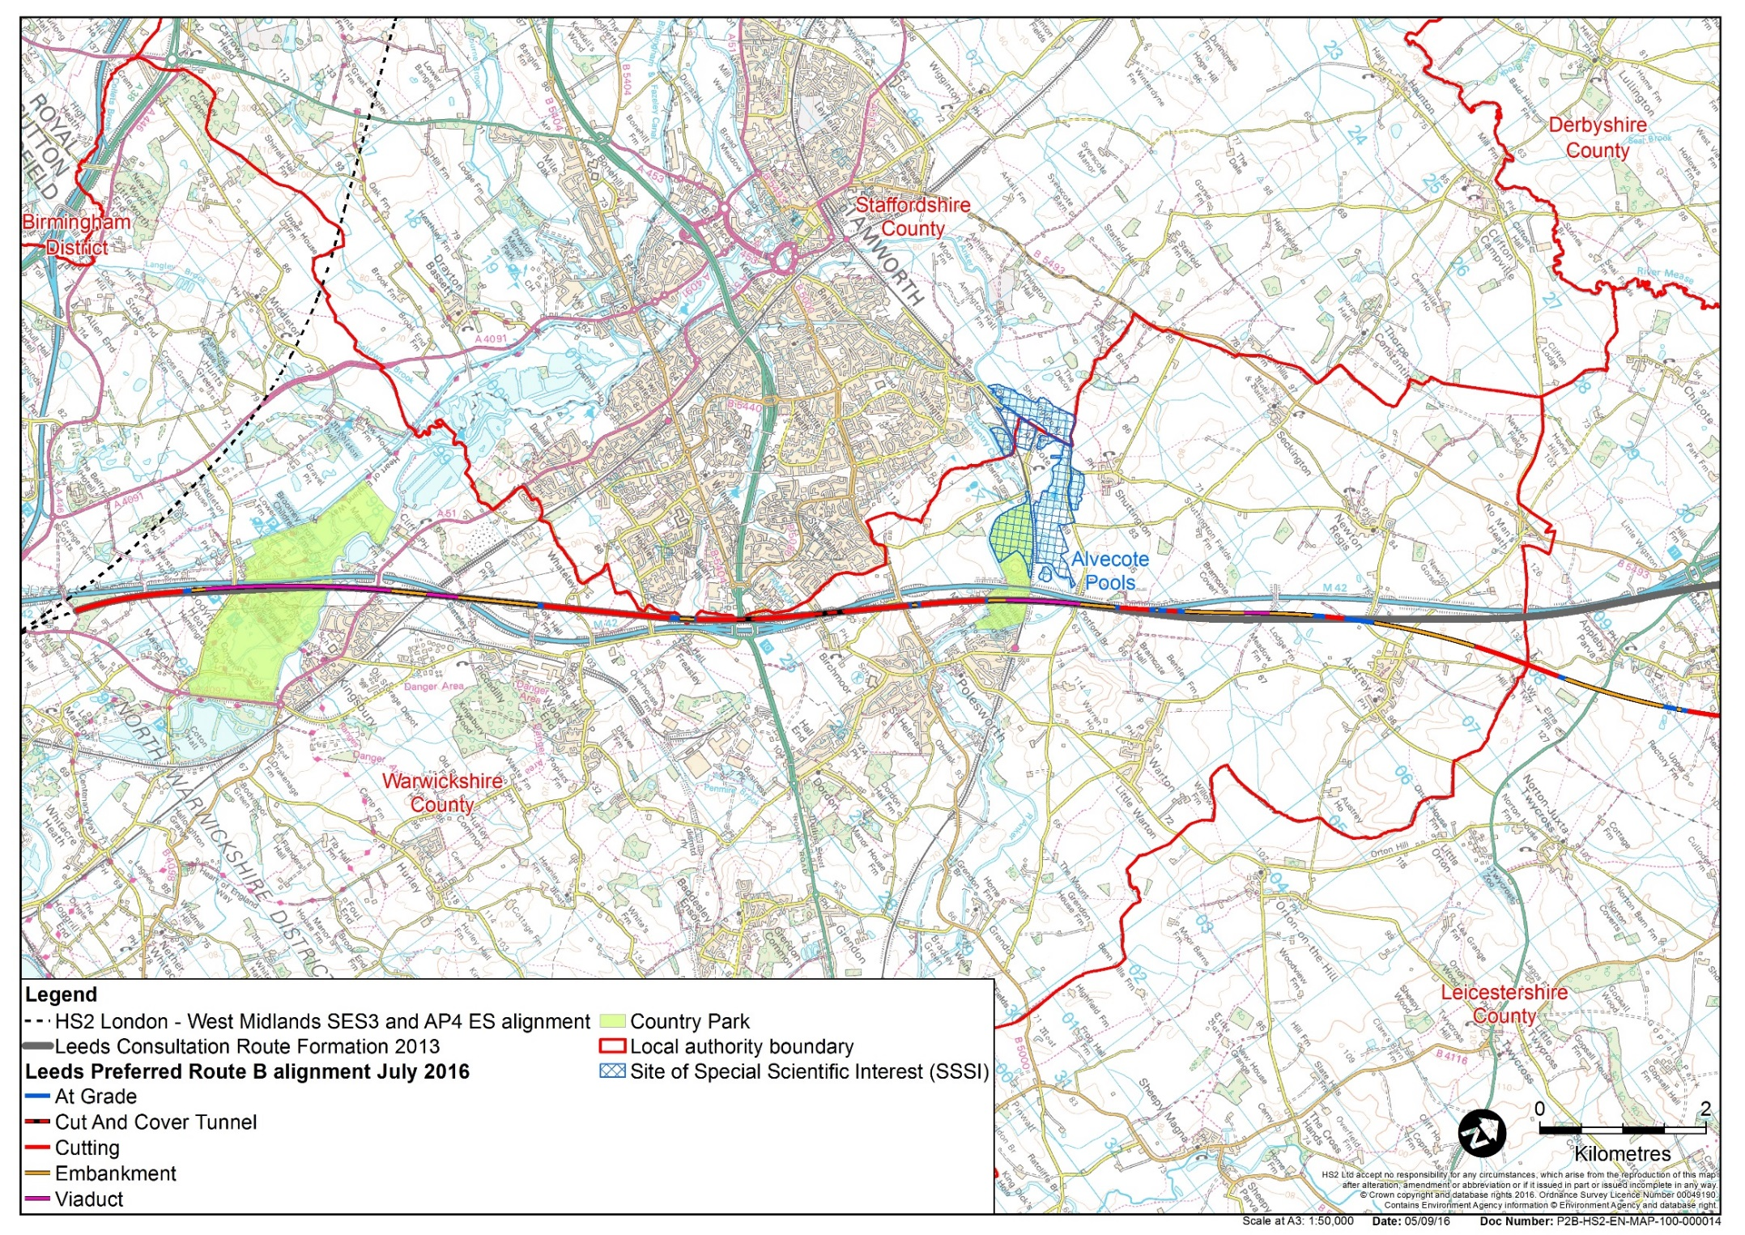
Kingsbury to Appleby Parva
Kingsbury Water Park
Tamworth (~100m)
Whateley
(0m)
SSSI
Kingsbury (~120m)
Birchmoor
(~100m)
Polesworth
(~300m)
Austrey
(-200m)
Pooley Country Park

Slide 18
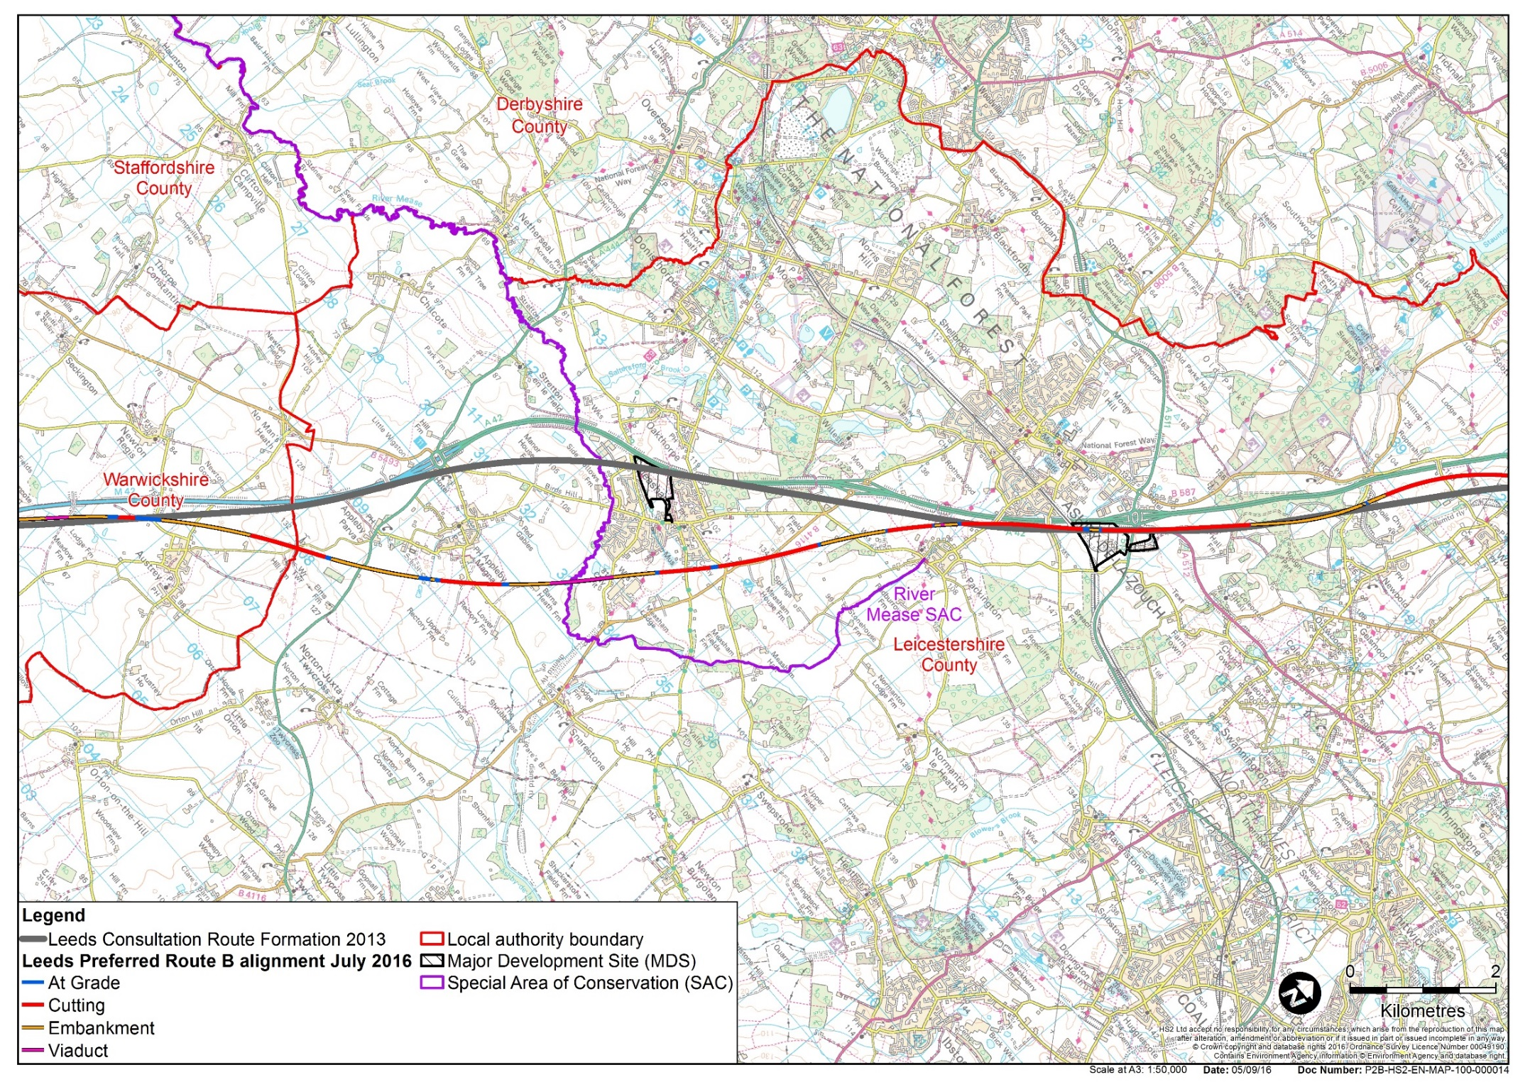
Appleby Parva to Tonge
Plastic Omnium
Measham Wharf MDS
Ashby-de-la-Zouch (~150m)
Appleby Magna (~180m)
Measham (~160m)
Packington (~250m)
Packington (~200m)
G Park Ashby-de-la-Zouch
Development Site
Brick Works

Slide 19
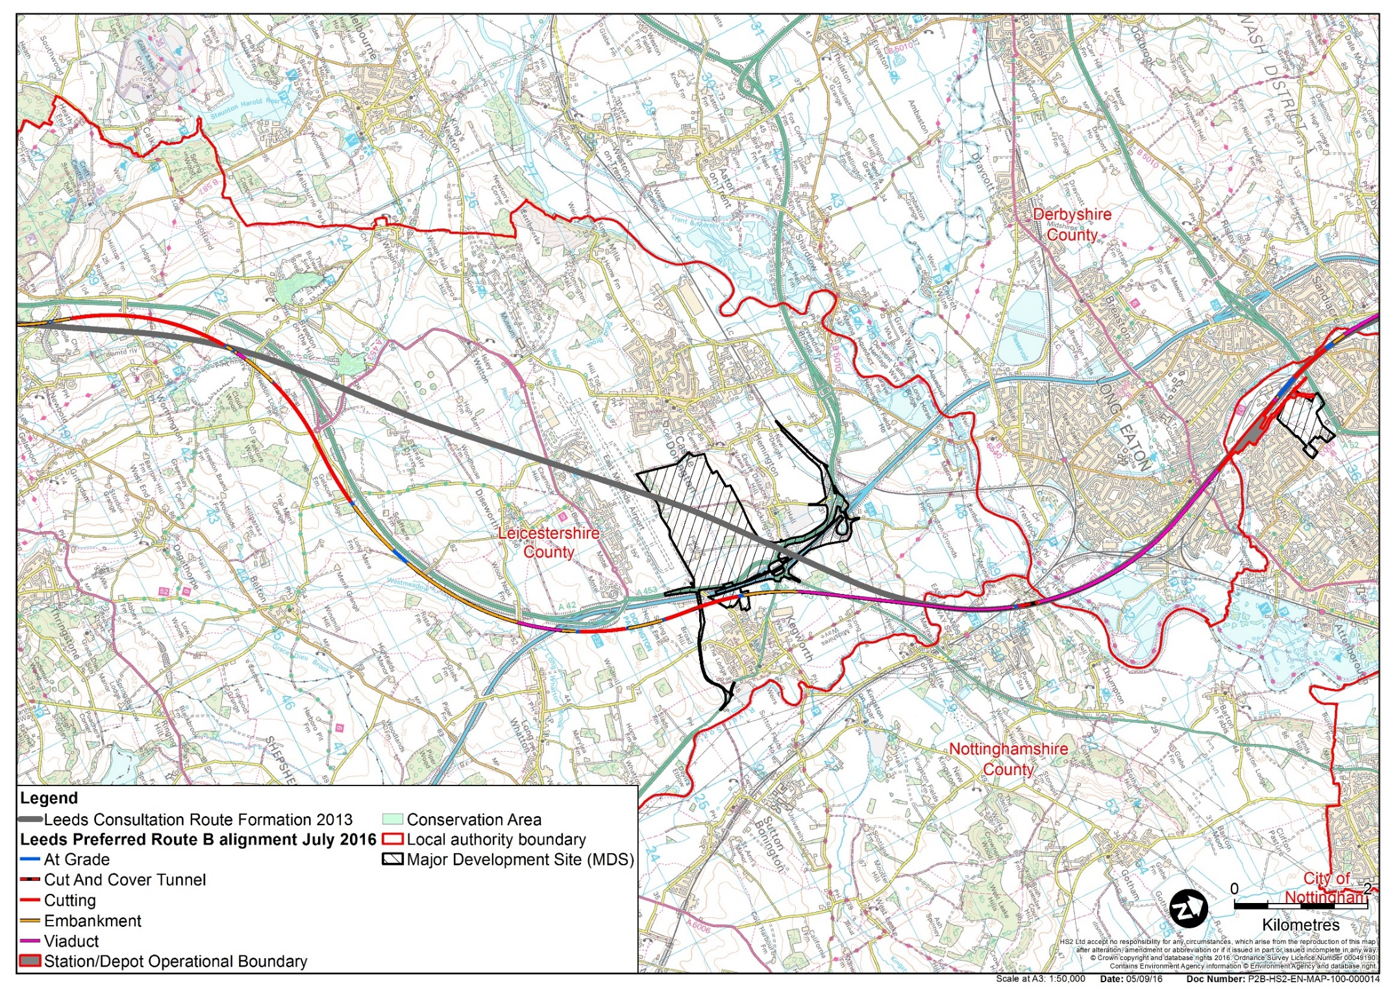
Worthington to Sandiacre
Breedon on the Hill Conservation Area
Tonge Conservation Area
Sandiacre
(~100m)
East Midlands Airport
East Midlands Strategic Gateway MDS
East Midlands Hub
Long Eaton
(~0m)
Toton
(~200m)
Lime Rise MDS
Kegworth
(~100m)
Land adjoining 90 Ashby Road Kegworth
Development Site

Slide 20
Next steps
Consultation open until - 9 March 2017
Route decision – 2017
We will continue to engage with you
Email: HS2enquiries@hs2.org.uk
Telephone: 0207 944 4908

Slide 21
Questions/Issues

