Slide 1
Parish Liaison Meeting
6th June 2018
Inspector Rich Jackson

Slide 2
North West Leicestershire NPA
1 Inspector
5 Sergeants
11 Police Constables
18 PCSO
4 Special Constables
8 Police Support Volunteers
11 Police Cadets
Policing a population of 98,600 and an area of 910 Square miles

Slide 3
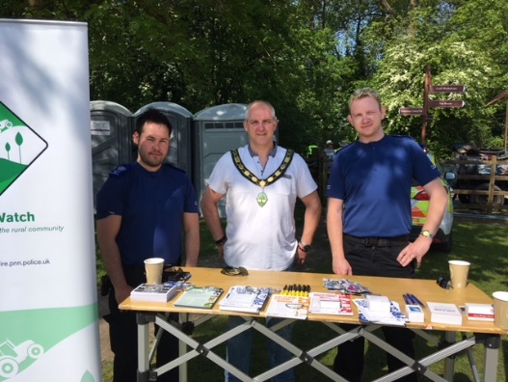
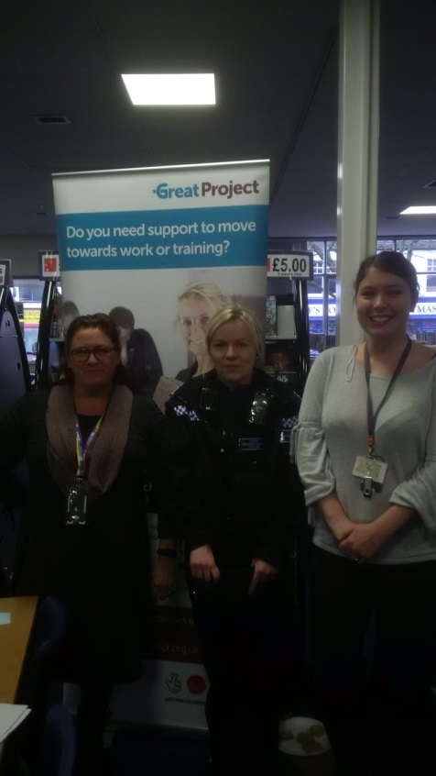
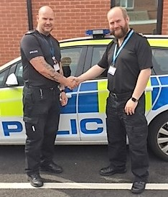
NPA Commander expectations to ensure success
Visible, accessible and locally known authority figures
Community involvement
Strong relationships and joint working with partners

Slide 4
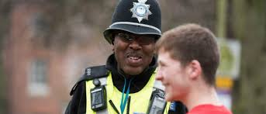
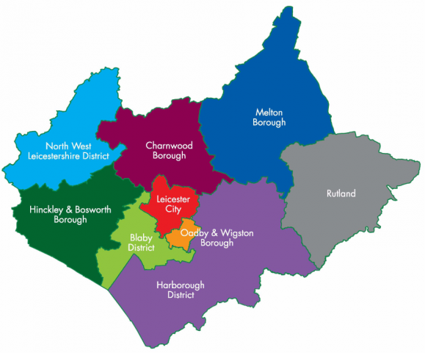
A typical day in the life of Leicestershire Police
Total Crime 212
Burglary Dwelling 16
Robbery 3
ASB incidents 67
Domestic incidents 49
Sexual Offences 5
Arrests 48
Positive Outcomes 46
Missing persons 9
Road Traffic Collisions 22
Child at Risk Referrals 51
Adult at Risk Referrals 22
Overall increase in crime 19.2%
999 calls last 12 months 139, 097
101 calls last 12 months 507, 440

Slide 5
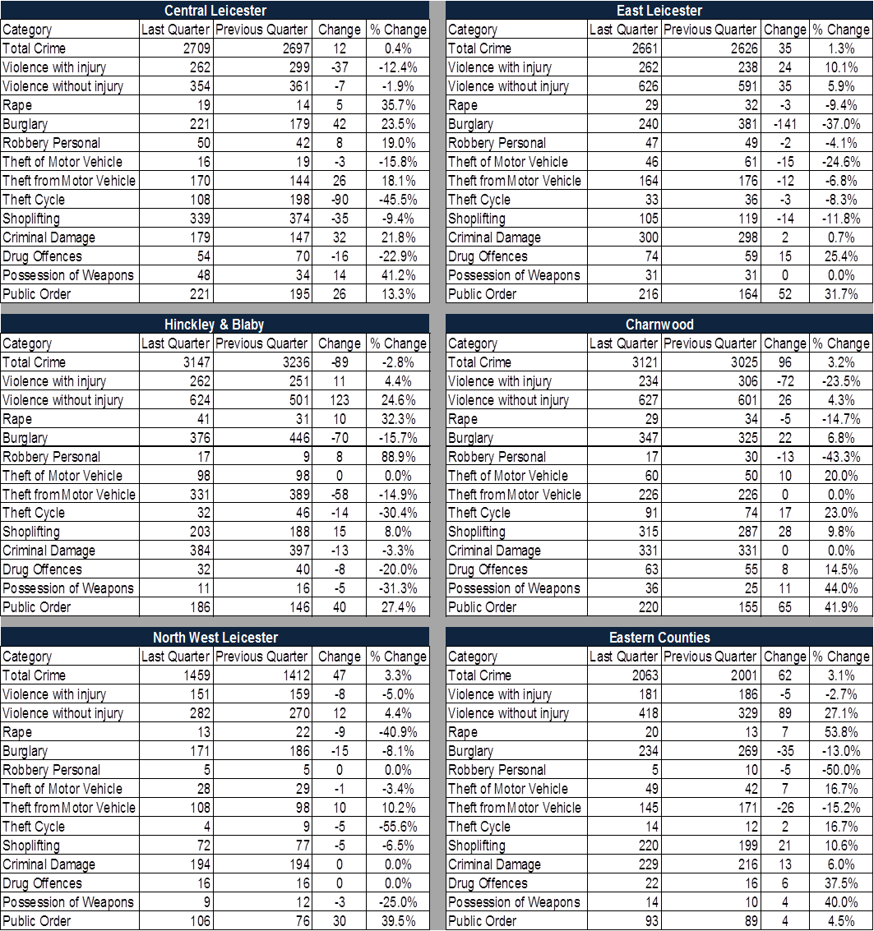
Crime by NPA
**Rolling Last Quarter - February 18 to April 18 / Rolling Previous Quarter – November 17 to January 18**

Slide 6
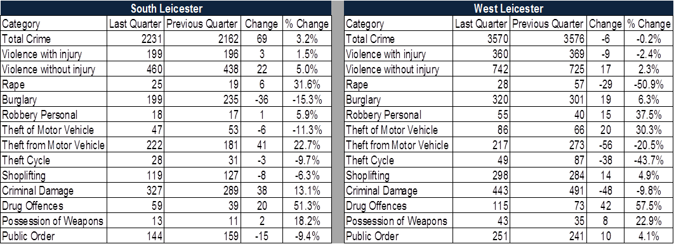
Crime by NPA
**Rolling Last Quarter - February 18 to April 18 / Rolling Previous Quarter – November 17 to January 18**

Slide 7
2006 vs 2018
2006
1 Police Officer per 430 Residents
2018
1 Police Officer per 601 Residents
That’s 1,206,432 less deployable Police Officer hours per year. *Currently have 547 less officers than we did in 2010.

Slide 8
Strategic Priorities 2018/19
Serious Organised Crime
Domestic Abuse
Child Sexual Exploitation & Abuse (135 enforcements against paedophiles leading to 85 offenders being brought to justice)
Cyber Crime
Knife Crime
Sexual Offences

Slide 9
North West Leicestershire Partnership Priorities 2018/19
ASB
Violent Crime
RURAL CRIME

Slide 10
Digital Policing
35x
more likely to be a victim of Cyber Crime than being mugged.
735,098
Reports of Cyber Crime 2016/17
1 million Britons fall victim to computer viruses each year
19%
of Britons have been defrauded more than once in a year
1 in 5 scams demand cash to release funds
5.6 million
Fraud & Cyber crimes per year in the UK (est)
170,856
Website, bank accounts & phone lines linked to cyber criminals taken down
£193m
Estimated yearly cost of Fraud and Cyber Crime

Slide 11
National rise in Recorded Knife Crime
 | England & Wales | England | East Midlands | Leicestershire
Possession of offensive weapons | 30,869 | 29,470 | 2529 | 524
Offences involving knives | 34,497 | 33,605 | 2245 | 492
% Change for offences with a knife since April 2015- March 2016 | 20% | 20% | 19% | 25%
Table 1: National Knife Crime Statistics
(Crime in England & Wales, year ending March 2017 - Office for National Statistics)

Slide 12
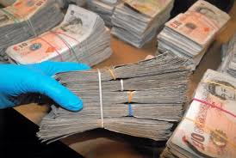
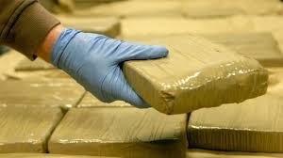
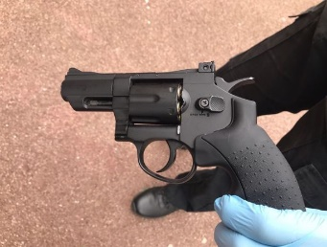
Emerging threat: County Lines
Urban gangs supplying drugs to suburban areas using dedicated “deal lines”
This is a major, cross cutting issue involving drugs, violence, gangs, safeguarding, criminal and sexual exploitation, modern slavery and missing persons.
This is a cross boarder, multi-agency threat.
Operation Gizmo- Leicestershire's response to County Lines

Slide 13
Working together
www.twitter.com/nwleicsnpa
www.facebook.com/NorthWestLeicsPolice/
northwestleicestershire.npa@leicestershire.pnn.police.uk
Recruit Special Constables www.leics.police.uk/join-us/specials
Encourage Volunteers www.leics.police.uk/join-us/police-support-volunteers
Online reporting www.leics.police.uk/report-online
Community Speedwatch www.bealocalhero.com/get-involved/
Neighbourhood watch www.leicestershireneighbourhoodwatch.co.uk/
Rural Watch www.leics.police.uk/categories/rural-watch – incorporates Horse Watch, Farm Watch, Church Watch, Heritage Watch
Get to know your local neighbourhood team www.leics.police.uk/local-policing

