Slide 1
www.nwleics.gov.uk
Jackie Sykes
Street Environment Officer

Slide 2
www.nwleics.gov.uk
Environmental updates on:
Partners
Lorry Litter
Littering
Keep Britain Tidy Spring Clean

Slide 3
www.nwleics.gov.uk
Partners
Engaging With:
Vehicle Litter Stakeholder Group-Keep Britain Tidy
Working Group on Roadside Litter-Litter Strategy for England DEFRA
Highways England
All Party Parliamentary Group-Westminster
People and Environment Division -Welsh Government

Slide 4
www.nwleics.gov.uk
Lorry Litter
Keep Britain Tidy are still considering the successful Pall Ex campaign for a national roll out
We have worked with KBT using their litter signage at hotspot areas
The business plan for 2017/18 will focus on lorry litter hotspot areas, particularly at snack wagon stations

Slide 5
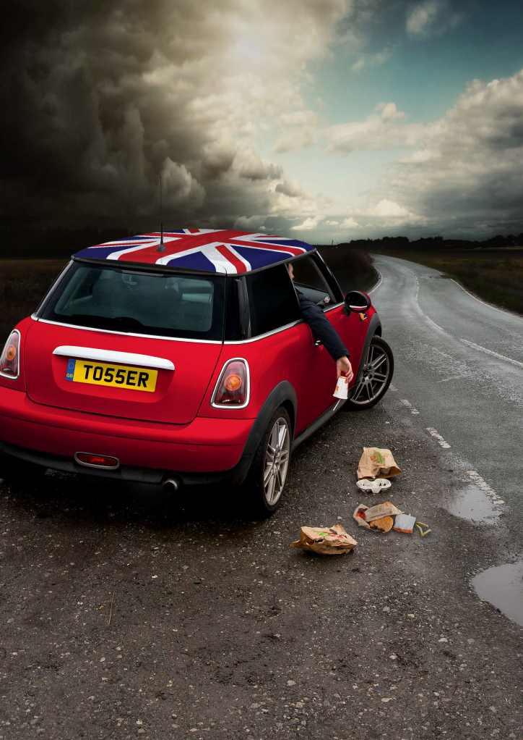
www.nwleics.gov.uk
Lorry Litter Signage

Slide 6
www.nwleics.gov.uk
Litter
We are working closely with McDonalds at Ashby, Coalville and Appleby Magna, conducting observations.
Further observations are booked W/C 19th December at peak times 12-2pm and 4-6pm
The CCTV van will be used for overnight observations once refurbished
This year 50 Fixed Penalty Notices* have been issued of which 46 have been paid so far
An updated schools education programme has been launched using a puppet which was named “Fudge” by Hugglescote Primary School
*Fly Tipping – 5 issued, 4 paid
Dog Fouling – 3 issued, 3 paid
Littering – Food 14 issued, 13 paid
Cigarette 27 issued, 25 paid
General 1 issued, 1 paid

Slide 7
www.nwleics.gov.uk
Keep Britain Tidy
Spring Clean 2017
When
-3rd to 5th March
Where
-Coalville Market cafe and railway line
Who
-Environmental Protection
-Street Cleansing
-Volunteers/businesses/schools
-Network Rail
-Market Traders
-Street Cleansing
-Parks
-Hermitage FM
What
-litter pick
-clear and dispose of tyres etc
-cut back foliage
-hanging baskets
-flower tubs
-bulb planting
-wall art
-mobile feature
Register at
www.keepbritaintidy.org
#GBSpringclean
There is a map detailing every event across the UK

Slide 8
www.nwleics.gov.uk
How to report an environmental crime……
Telephone Customer Service Centre 01530 454545
Email environmental.protection@nwleicestershire.gov.uk
With the following…….
Date, time and type of incident.
Address/location of incident.
Description of offender.
If applicable……..
Details of vehicle, registration, make, model and colour.
Type/size and colour of dog.

Slide 9
www.nwleics.gov.uk
Further Environmental Information
Jackie Sykes or Ruth Mulvany on 01530 454600
www.nwleics.gov.uk/litter
www.lovewhereyoulive.org
www.keepbritaintidy.org
customer.services@nwleicestershire.gov.uk
Customer Service Centre 01530 454545

Slide 10
www.nwleics.gov.uk
Thank you for your attention.
Any Questions?

