Slide 1
Community Safety for Parish Councils
New Projects to support the Parish Councils
Paul Collett, Community Safety Team Leader

Slide 2
What do we actually do?
We deliver Targeted crime hotspot reduction schemes, such as body cameras, leaflet drops and roadshows
We use legal powers to enforce
Funded by the NWLDC and PCC
Manage CCTV, New Mobile camera
Manage the Community Safety Partnership
Work with Police and partners to understand the issues, delivering local projects
Strategic planning, local response, supporting LLR agenda

Slide 3
Our Team
Chris Brown -Team Manager for Safer & Stronger Communities Team
Paul Collett -Team leader
Gillian Haluch -Community Safety (Protecting Vulnerable People)
Charlotte Keedwell - Community Safety (ASB)
Miriam Bentley-Rose - Community Safety (Equalities Officer)

Slide 4
Getting involved, here to help
We support your local beat team
If you are having issues we will try to help find solutions
We are a small team so we are priority focused

Slide 5
Barn event
Bringing Community Safety to the rural community

Slide 6
Our proposed event
We want to provide a workshop/session for rural business
Responding to NFU crime report 2017 and theft of cash machines
Bringing senior officers to talk about these issues
Provide a networking opportunity with suppliers of crime prevention Items

Slide 7
The event plan
Evening session timed for the end of the working day, designed for the workers. We will provide food!
Located on a farm or business.
3 sessions - South, Central and North.
While Parish Councils are welcome, you are not the target audience!
Presentations from Chief Constable and Police and Crime Commissioner
We want a 2 way conversation!
We will ask what to add at the next event.

Slide 8
Safeguarding
Supporting the vulnerable

Slide 9
Safeguarding at NWLDC
All public bodies have a duty of care ethically, morally and legally.
Safeguarding is part of Community safety, but can cover any issue of vulnerability
Safeguarding can include
Abuse
Neglect
Financial difficulties
Housing
Substance misuse
We have a small number of Designated Safeguarding Officers (DSOs) who manage the cases with IT support

Slide 10
How to get involved
We will be delivering Safeguarding training next as part of the Community Focus training plan.
We are here to help, we will support you if you need it.
If you have concern, let us know via the Community focus officers or talk to your local Police.

Slide 11
Mobile CCTV
Additional CCTV coverage in Hotspots

Slide 12
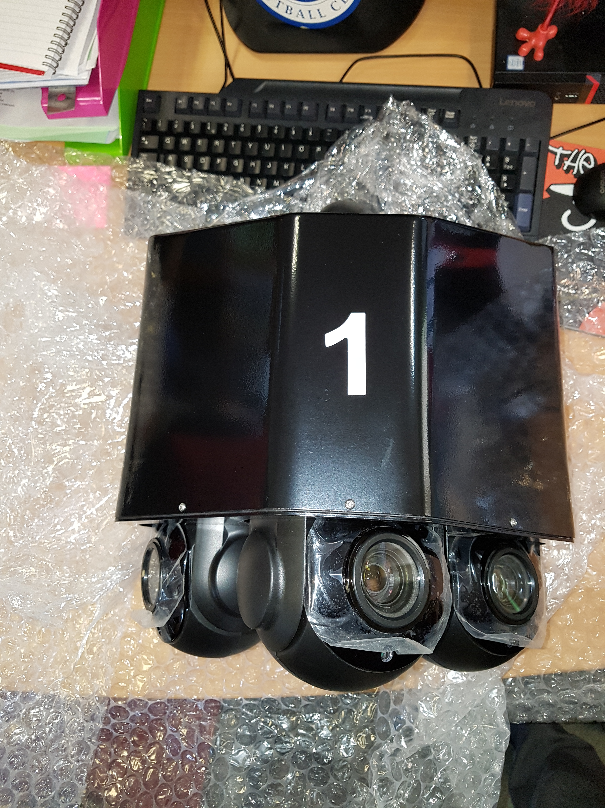
Nomad Multi HD
4 HD cameras in 1
3 are PTZ IR
Sentry cam
4G and WiFi
Laptop is in CCTV control
On test in Ashby, evidence has been seized
Any group can request a camera.
Deployed by the Joint Action Group.
Decision made on a priority basis.

Slide 13
Still Image (sub)

Slide 14
Still (Main)

Slide 15
Night Still (main)

Slide 16
Potential Issues
Moves can take a while to sort
LCC lamp posts may be difficult
Cost to move is around £300.00*
We only have a single unit
Each deployment will need to have a Privacy Impact Assessment (PIA)
We must prove the PRESSING NEED
*We have budget to cover this

Slide 17
Supporting Villages Project
Empowering Parishes to support residents

Slide 18
New project for consideration!
We want to enable you to support your village
Voluntary scheme to support you. NOT replace us!
The idea is to train and equip you to property mark items. You will also have a supply of FREE items to hand out
Each scheme member will have their own box containing
Shed alarms
Window alarms
Attack alarms
Pens, wraps and stickers
marking kit (creMark)
Limited Funding!

Slide 19
How will it work?
That’s up to you!
We will provide ‘the box’ and the training. (To your nominated champion)
You know how to offer this to your community, and we will support you, not dictate
We can support events but on a priority basis
We will ask for tracking on the items handed out
We will restock as long as funds remain

Slide 20
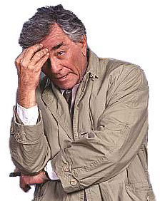
One more thing……
Look out for our Crime survey
emailed out in Jan!!!!

Slide 21
Paul Collett Community Safety Team Leader 01530 454719 CSAFETY@nwleisestershire.gov.uk

