Slide 1
www.nwleics.gov.uk
Parish Liaison meeting – 8 June 2016
Welcome
John Richardson
Head of Community Services

Slide 2
www.nwleics.gov.uk
Local Plan update
Katie Mills
Planning Policy Team Leader

Slide 3
www.nwleics.gov.uk
Training/workshop update
Section 106 & Community Infrastructure Levy
16 June 2016 - 6pm at
the council offices, Coalville
Catherine Ridgway
Community Focus Officer

Slide 4
www.nwleics.gov.uk
Multi vehicle activated signs
Mike Crowe
Westcotec
and
Lee Quincy
Leicestershire County Council

Slide 5
www.nwleics.gov.uk
Parish Community Resilience Plans
John Brown
Civil Contingencies Officer
NWLDC

Slide 6
www.nwleics.gov.uk
Playing Pitch Strategy
John Richardson
Head of Community Services
NWLDC

Slide 7
Parish/Town Clerks Network update
Andrea Robinson
Clerk to Ashby Woulds Town Council

Slide 8
www.nwleics.gov.uk
Community libraries in the district
Wendy May
Community Focus Team Leader

Slide 9
www.nwleics.gov.uk
June events and
funding opportunities
Wendy May
Community Focus Team Leader

Slide 10
www.nwleics.gov.uk
A busy time...
Download Castle Donington 10 to 12 June
One Kegworth Kegworth 10 to 13 June
High Street Summer Fest Coalville 11 June
Proms in the Park Coalville 11 June
Street Party Ashby de la Zouch 12 June
Picnic in the Park Donisthorpe 12 June
Picnic in the Park Coalville 12 June
Afternoon Tea Oakthorpe 26 June

Slide 11
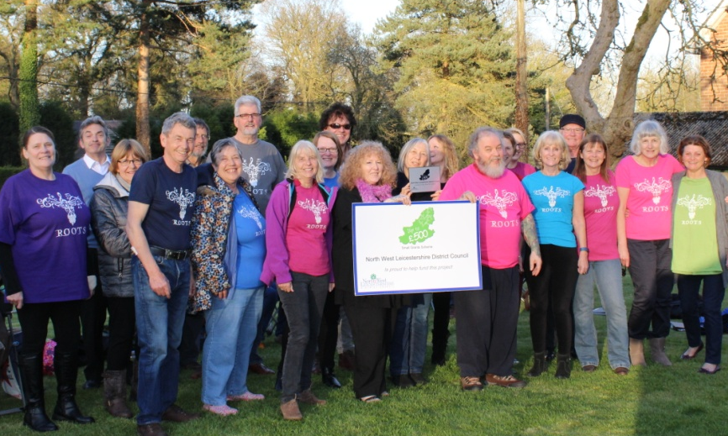
www.nwleics.gov.uk
www.nwleics.gov.uk
Small Grant Scheme up to £500
for new and innovative projects
for community and voluntary
groups – 50% match funded.
Coalville Special Expenses Community Chest up to £250 to support community activities that meet the needs of residents in Coalville, Bardon, Snibston, Thringstone and Greenhill
Notes:
Small Grant Scheme - £500, please encourage groups in your communities to apply for this
Coalville Special Expenses ‘Community Chest’ – applies to limited areas, but again encourage applications

Slide 12
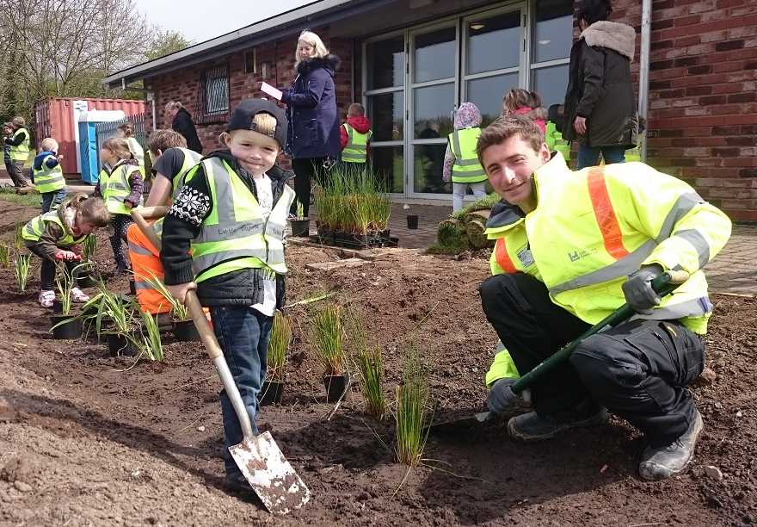
www.nwleics.gov.uk
www.nwleics.gov.uk
Green Grants of up to £500 for environmentally focussed community projects, available to groups and organisations. Cash match funding of £500 is required.
Notes:
Green Grants (part of the Green Footprints Challenge) - £500 for environmental initiatives, cash match funding required.
Photo of Trent Rivers Trust project at Measham Leisure Centre

Slide 13
www.nwleics.gov.uk
www.nwleics.gov.uk
Green Shoots helps communities to brighten up their areas in Spring. Narcissi, daffodil, crocus and bluebell bulbs are on offer on a match-funding basis. Minimum order of 2000 bulbs required. 1000 bulbs cost approx £100, therefore a minimum of £100 cash match funding required.
Notes:
Green Shoots (part of the Green Footprints Challenge) – you can order up 2000+ bulbs, cash match funding required. 1000 bulbs cost approx £100, therefore minimum of £100 cash match funding required.
Photo of volunteers at Swepstone & Newton Burgoland bulb planting (100% daffodils)

Slide 14
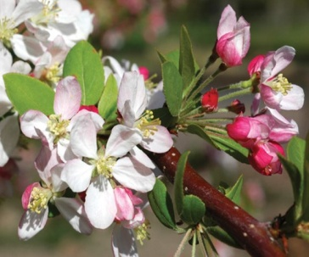
www.nwleics.gov.uk
www.nwleics.gov.uk
Free Tree Scheme – the ever popular scheme that offers two free trees to every household in the district. Run in partnership with the National Forest Company, the scheme has already seen thousands of trees planted across the district.
Hedge Fund - Open to parish councils, landowners, local groups and schools. Run in partnership with the National Forest, the scheme provides up to 30 metres of native hedging.

Slide 15
Leicestershire and Rutland Association of Local Councils
LRALC updates
Jake Atkinson
Chief Officer

Slide 16
Formed by Parish Councils - Run for Parish Councils - Delivering to Parish Councils Current Sector Issues and Update
Leicestershire and Rutland Association of Local Councils
Jake Atkinson
Chief Officer, LRALC

Slide 17
National
EU Referendum and Purdah
Tenth edition of ‘Charles Arnold Baker’
NALC/LGA joint conference on Devolution
National pay award agreed
Transparency Fund 2016-17
New ruling exempting small developments from affordable housing and financial contributions
Local
New LRALC briefing on the role of Chairman.
New training courses (what do YOU want to see?)
LRALC Strategic Plan 2016-19 & Member Survey
LCC parish website server shut down 31st August

Slide 18
Community Focus Team - contact details
District wide and special projects
Wendy May – 01530 454769
wendy.may@nwleicestershire.gov.uk
Ashby, Measham and Moira
Emma Trahearn – 01530 454567 emma.trahearn@nwleicestershire.gov.uk
Coalville Area
Catherine Ridgway – 01530 454740
catherine.ridgway@nwleicestershire.gov.uk
Northern Parishes
Gillian Squires – 01530 454771
gillian.squires@nwleicestershire.gov.uk

Slide 19
www.nwleics.gov.uk
Dates for your diaries –
2016 Parish Liaison meeting dates
4.45pm for 5.00pm start
Wednesday 7 September 2016
Wednesday 7 December 2016

Slide 20
www.nwleics.gov.uk
Completion of evaluation questionnaires
Meeting close

