Slide 2
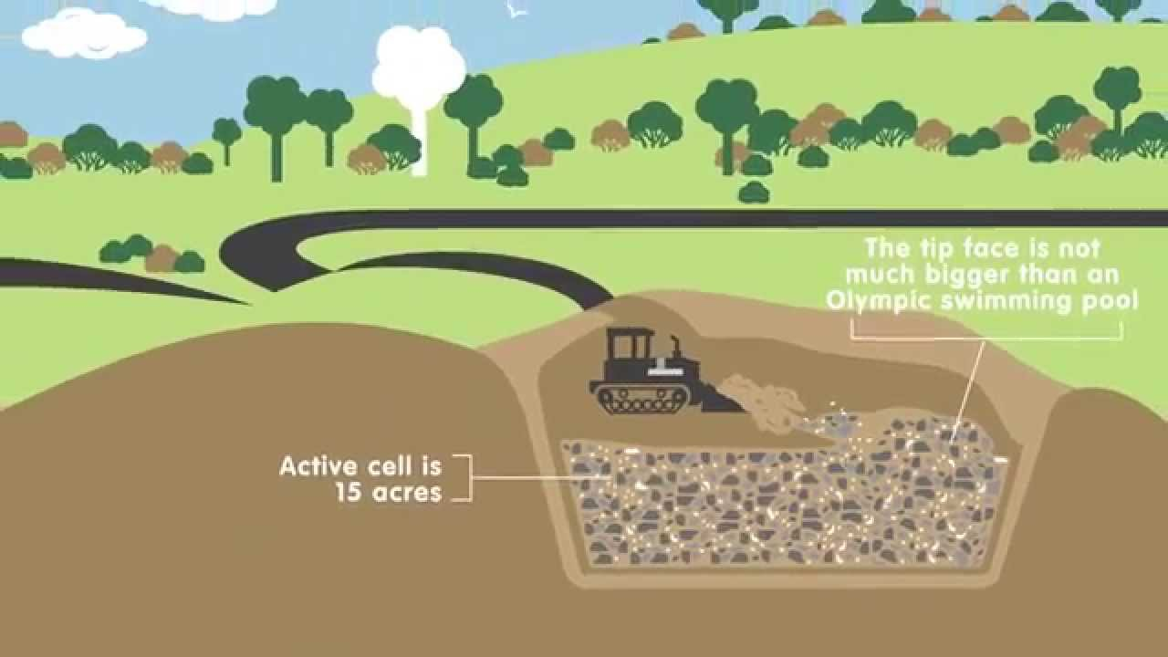
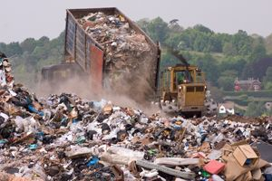
Introduction
The current recycling rate for NWLDC is 46%. Over the last 5 years it’s been between 46% and 47% but has plateaued.
As part of the Council Delivery Plan for 2018/19 we’re required to increase dry recycling by 100 tonnes over the next 3 years. To put this figure into context during 2017/18 we collected nearly 7,000 tonnes of dry recyclables.
The UK is required to meet a 50% recycling target by 2020 which has been set by the EU.
Whilst it is unclear how Brexit will affect our obligation to meet this target, the strategy will allow us to focus on minimising waste sent to landfill, whilst maximising the quantity and quality of waste recycling from residents and businesses.

Slide 3
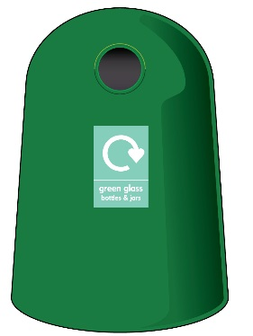
What are we currently doing?
Provide households with a kerbside recycling collection of:
Glass bottles & jars (red box)
Cans, tins & plastics (red box)
Paper, magazines, envelopes, junk mail, etc. (blue bag)
Cardboard (yellow bag)
Garden waste (green bin with brown lid or smaller black bin with brown lid)
Textiles (carrier bags, not charity bags as legally we cannot collect them).
Bring sites for cardboard, tins, cans, glass and paper are provided using banks across the district on leisure centre, library and supermarket car parks.

Slide 4
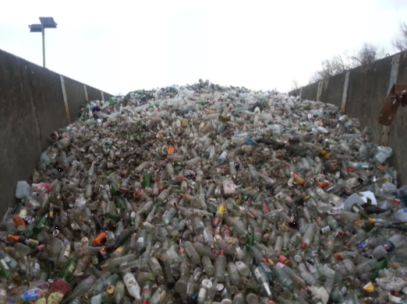
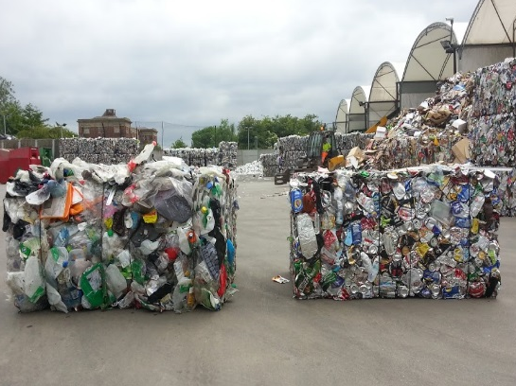
Linden Way Depot
Cardboard is tipped loose from the collection vehicles into the bays. It is then baled into cubes for easy transportation to reprocessing companies, where it’s processed into new cardboard.
Paper is tipped into the bays from the collection vehicles. It is loaded loose into lorries for transportation to companies who process it into newspaper and low-grade paper.
Glass is loaded loose into lorries for transportation to companies who process it into new jars and bottles.
Plastics, tins & cans are tipped loose into the bays. The cans and tins are separated from the plastics using magnets. We bale the plastics separately to the aluminium cans and steel tins as they are worth more. They are transported to reprocessing companies who recycle them back into new products.
Sales of recyclables generate approximately £500,00 pounds a year.
Garden waste is taken to a composting facility at Lount near Ashby.

Slide 5
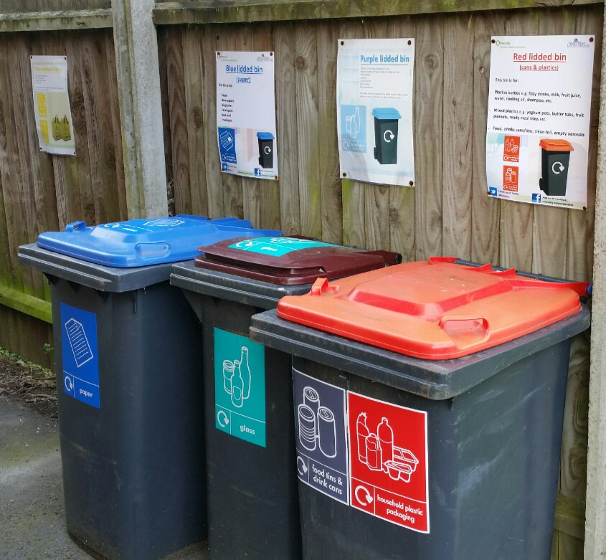
New initiatives to further increase recycling
Residents are now required to recycle glass in a separate red box (May 2018)
Look into the financial and operational implications of introducing food waste collections. Food waste is this biggest waste stream contained within the refuse bin, although it is known to reduce when food waste collection is introduced because people realise how much they throw away.
Introduce more recycling bins in all Council Owned buildings in partnership with Property Services.
Review all council owned housing which are provided with communal bins for recycling - update signage, check the correct bins and number of bins are provided.

Slide 6
New initiatives to further increase recycling
Targeted campaigns – identify areas where recycling participation is low and determine what the barriers are e.g.
Language
Literacy
Knowledge
Not having the recycling containers at home
Work with the Housing team, Housing Associations and possibly Community Focus Officers to carry out communications with council and housing association tenants through door-stepping campaigns, roadshows etc.
Recycling competitions between parishes, streets and also offices/departments at the Council Offices to increase recycling participation.

Slide 7
New initiatives to further increase recycling
New build properties - work with the Planning team at the pre-application stage to ensure recycling is convenient and easy. Reduce the reliance of bin collection points by ensuring we are indemnified against any damage to roads, so kerbside collections are possible.
Investigate if new build properties can be fitted with food disposal units for kitchen sinks. Along with planning’s assistance we would need to engage with Severn Trent.
Heating systems in new and existing housing stock belonging to NWLDC – moving away from coal fires, as ash contributes to our waste to landfill tonnage. Work with the Housing team to establish no. of properties still on coal, and/or when if they will be put on to gas or an alternative fuel.

Slide 8
Communications
Social media
NWL Enviro twitter account
NWL District Council account
This is NW Leics Facebook page
NWLDC YouTube account
Social media communications such as:
Name the recycling vehicles competition
Material of the month
Did you know? (various recycling facts or tips)
Videos of recycling being processed at the depot

Slide 9
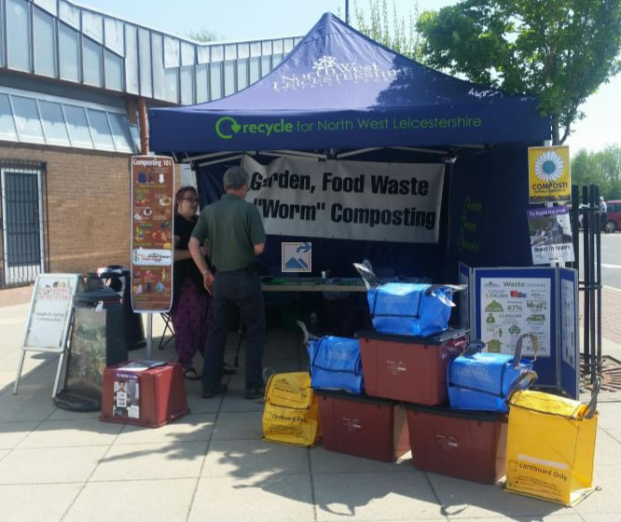
Communications (continued)
More school visits and tours of the depot. Engage with primary schools, secondary schools and colleges working in partnership with Street Environment Officers
Engage with parish councils to work together on new recycling initiatives and campaigns at both the planning and implementation stages
More talks with and local groups such as WI’s, Scouts and Rotatory Clubs etc.
Roadshows
International Compost Awareness Week (May) - promoting compost bins
National Recycling Week (September) – promoting kerbside recycling
District Days (June, July & August) – promoting kerbside recycling
Promote kerbside recycling scheme at Main offices, Leisure Centres and Tourist Information Centre and possibly Parish Council buildings.

Slide 10
Questions…
…or contact
Claire Preston
Waste Services Team Manager
t: 01530 454 663
e: claire.preston@nwleicestershire.gov.uk
John Bright
Waste Services Development Officer
t: 01530 454 592
e: john.bright@nwleicestershire.gov.uk

