Slide 1
Coalville’s Memorial Clock Tower and Memorial Square
The Coalville Memorial Clock Tower Education Pack
Teacher’s Slides G
Key Facts and Figures

Slide 2
The Clock Tower in numbers
21 metres high
4 metres square base
54,000 bricks
3 commemorative tablets for WWI
4 commemorative tablets for WWII added in 1950
1 tablet to commemorate the 50th anniversary of WWII 1995
2 tablet added in 2014 to commemorate those who have died in recent wars

Slide 3
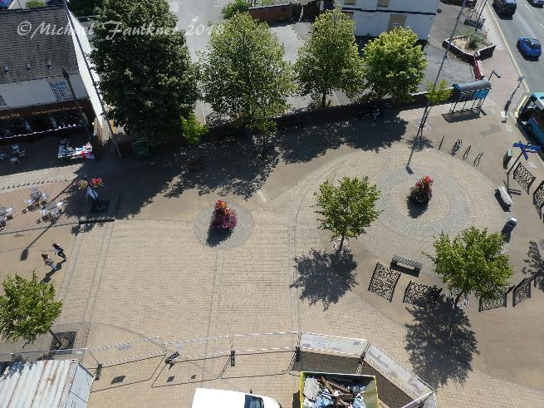
Sky’s the limit!
The Clock Tower stands at 21 metres above the pavement level

Slide 4
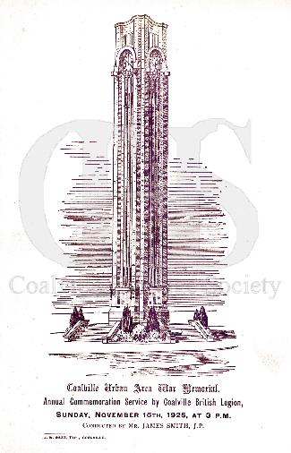
The unveiling
The Memorial Clock Tower was unveiled on the 31 October 1924 by Mary Booth.
The event was attended by some 10,000 people.
Every year since then there has been a Commemoration Service at the Clock Tower to remember all the people whose names are on the Memorial.
Left: cover of the programme from the first Commemoration Service

Slide 5
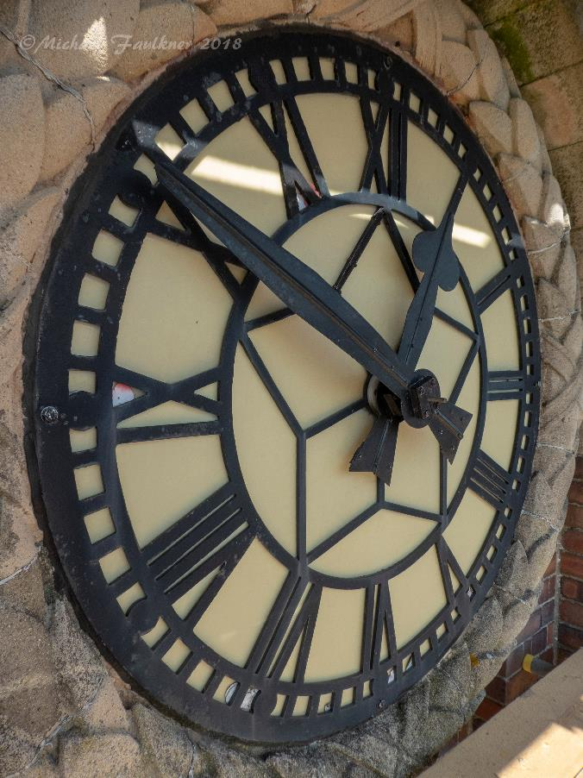
The Clock Tower still has its original clock faces….

Slide 6
Can you spot what’s wrong with this picture?

Slide 7
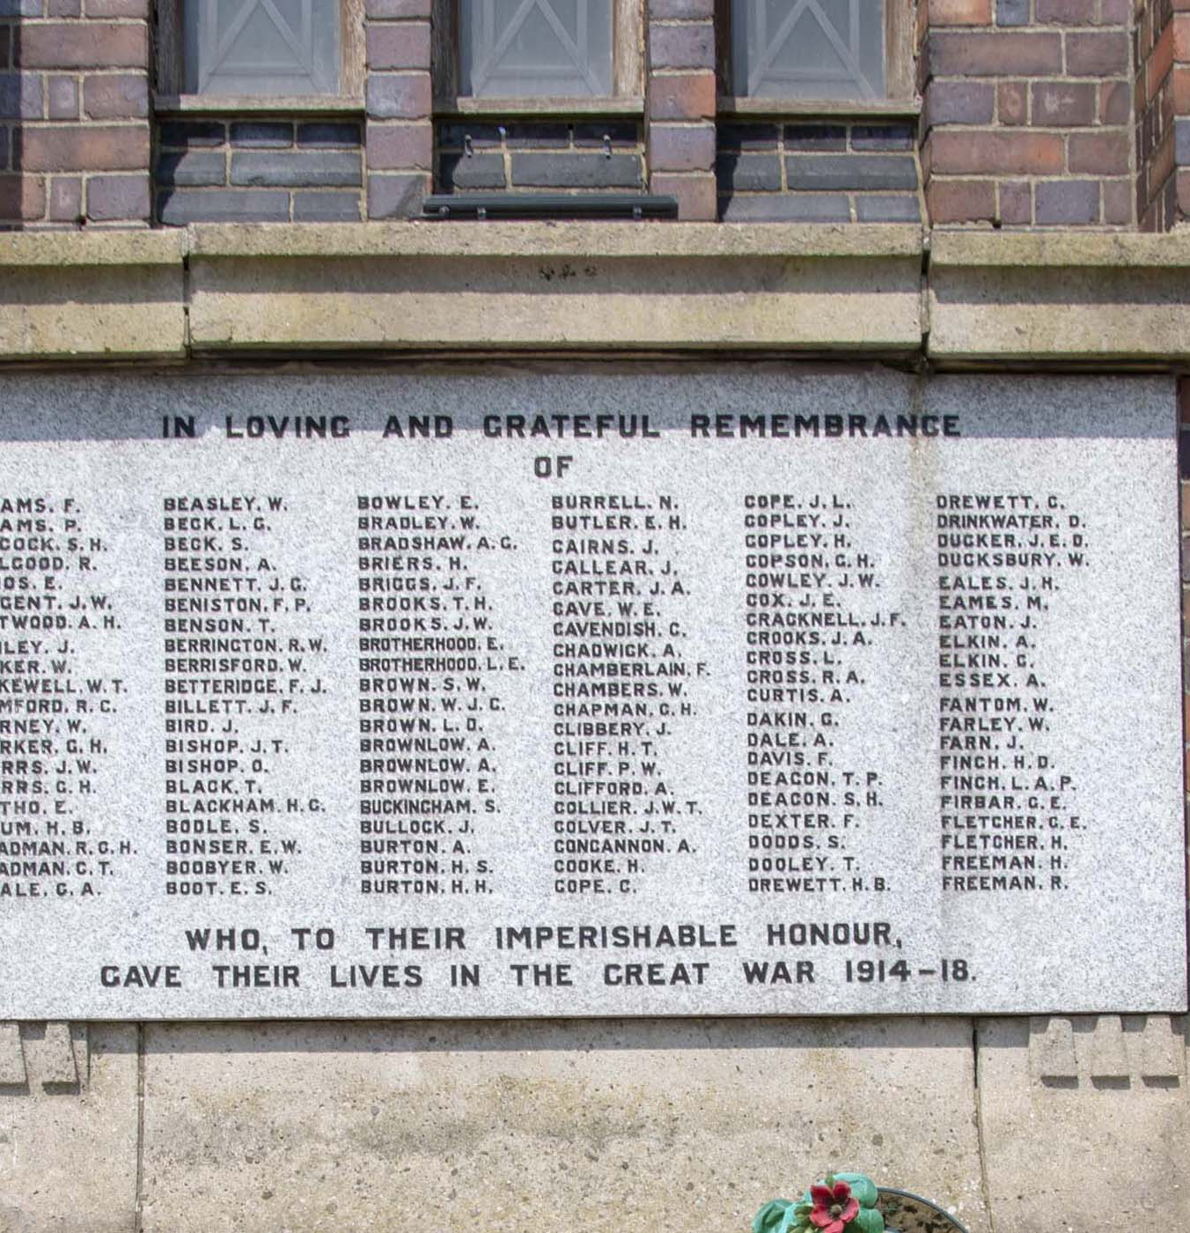
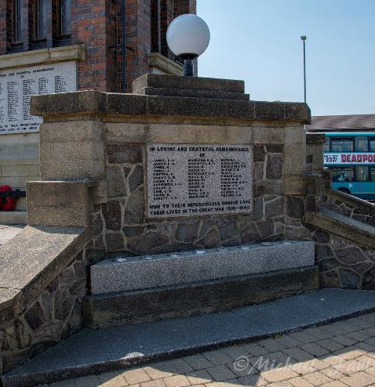
Remembering the fallen in the World Wars

Slide 8
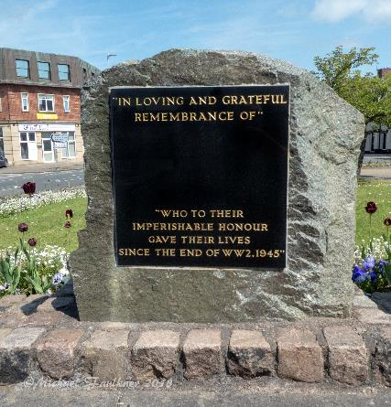
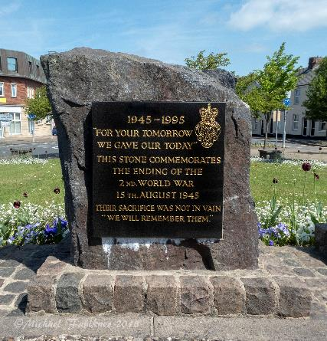
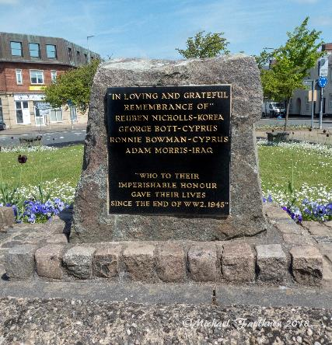
The Memorial Clock Tower remembers those who have died in recent conflicts

Slide 9
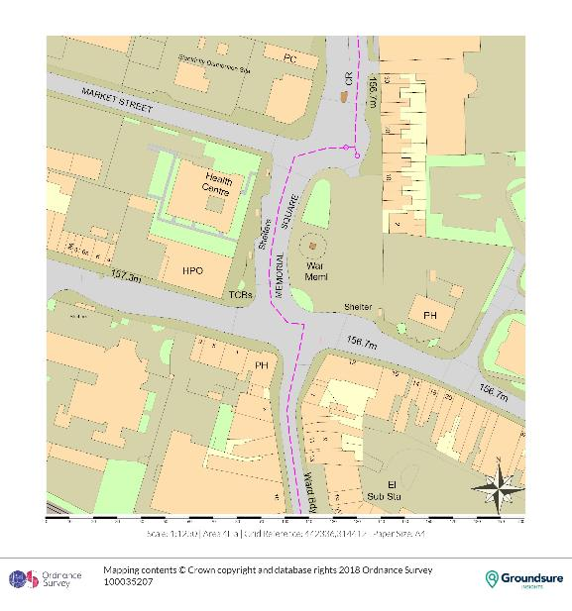
Plan of Memorial Square now

Slide 10
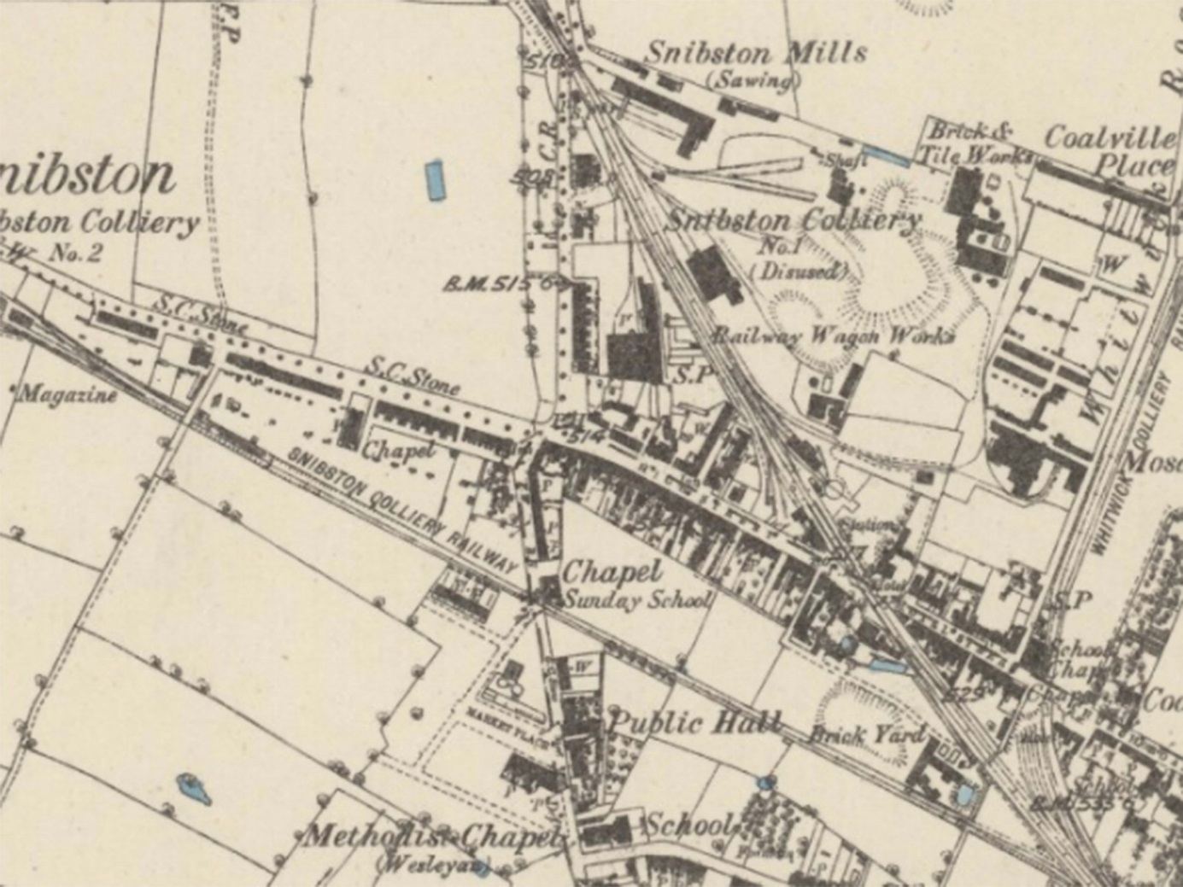
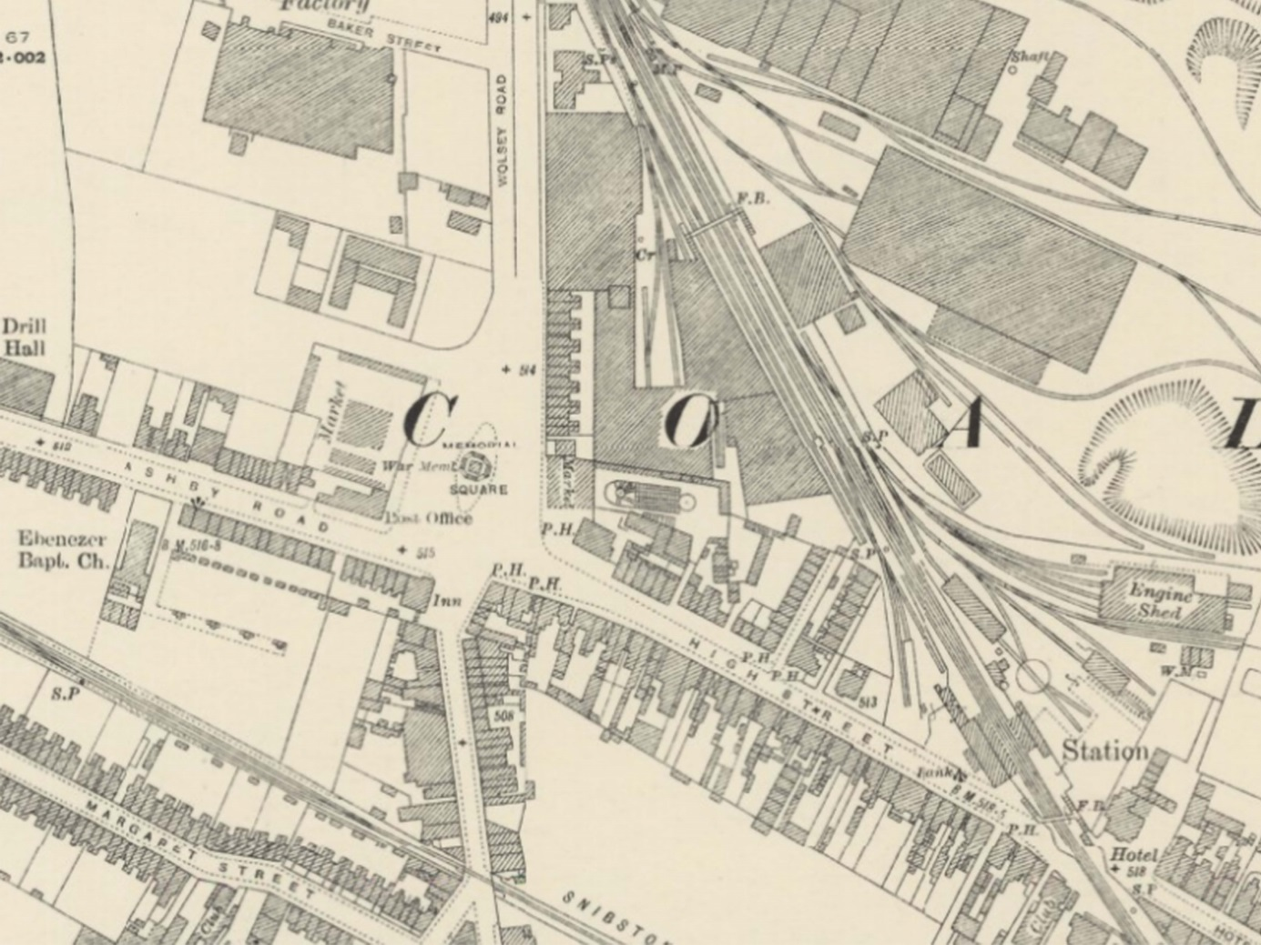
Coalville in the 1880s
Coalville in the 1920s
Where will Memorial Square be built?
Can you see the Clock Tower and Memorial Square?

Slide 11
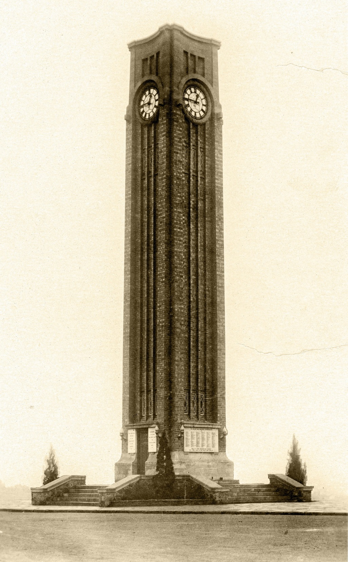
When the Clock Tower was built Memorial Square was created…
Traffic used to go around a kerbed island on which the Tower stood
How has the Clock Tower changed since then?
Left: The Memorial Clock Tower pictured soon after being unveiled in 1925 by Mary Booth

Slide 12
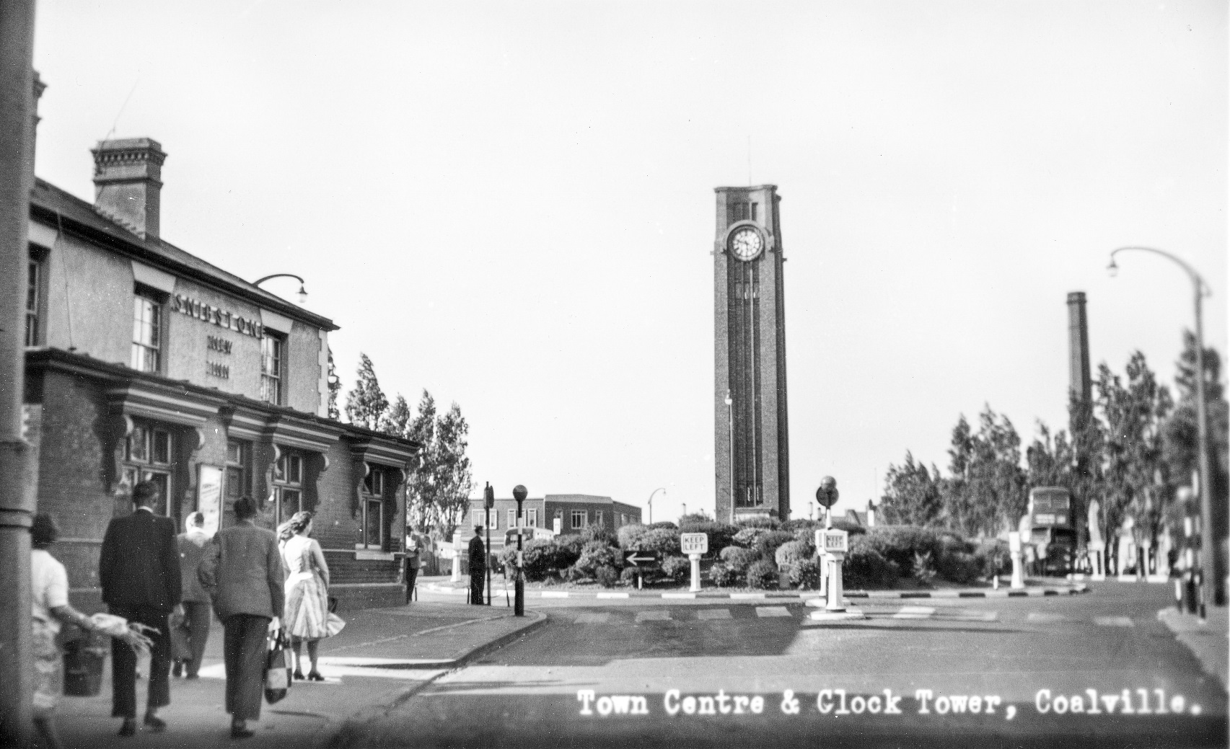
In the late 1940s a traffic island was created at the junction of Ashby Road, Belvoir Road and High Street.
At the same time the area around the Clock Tower was extended to the north with a hedged flower bed being added.
Can you see the pub on the left. Is it still standing in Coalville today?

Slide 13
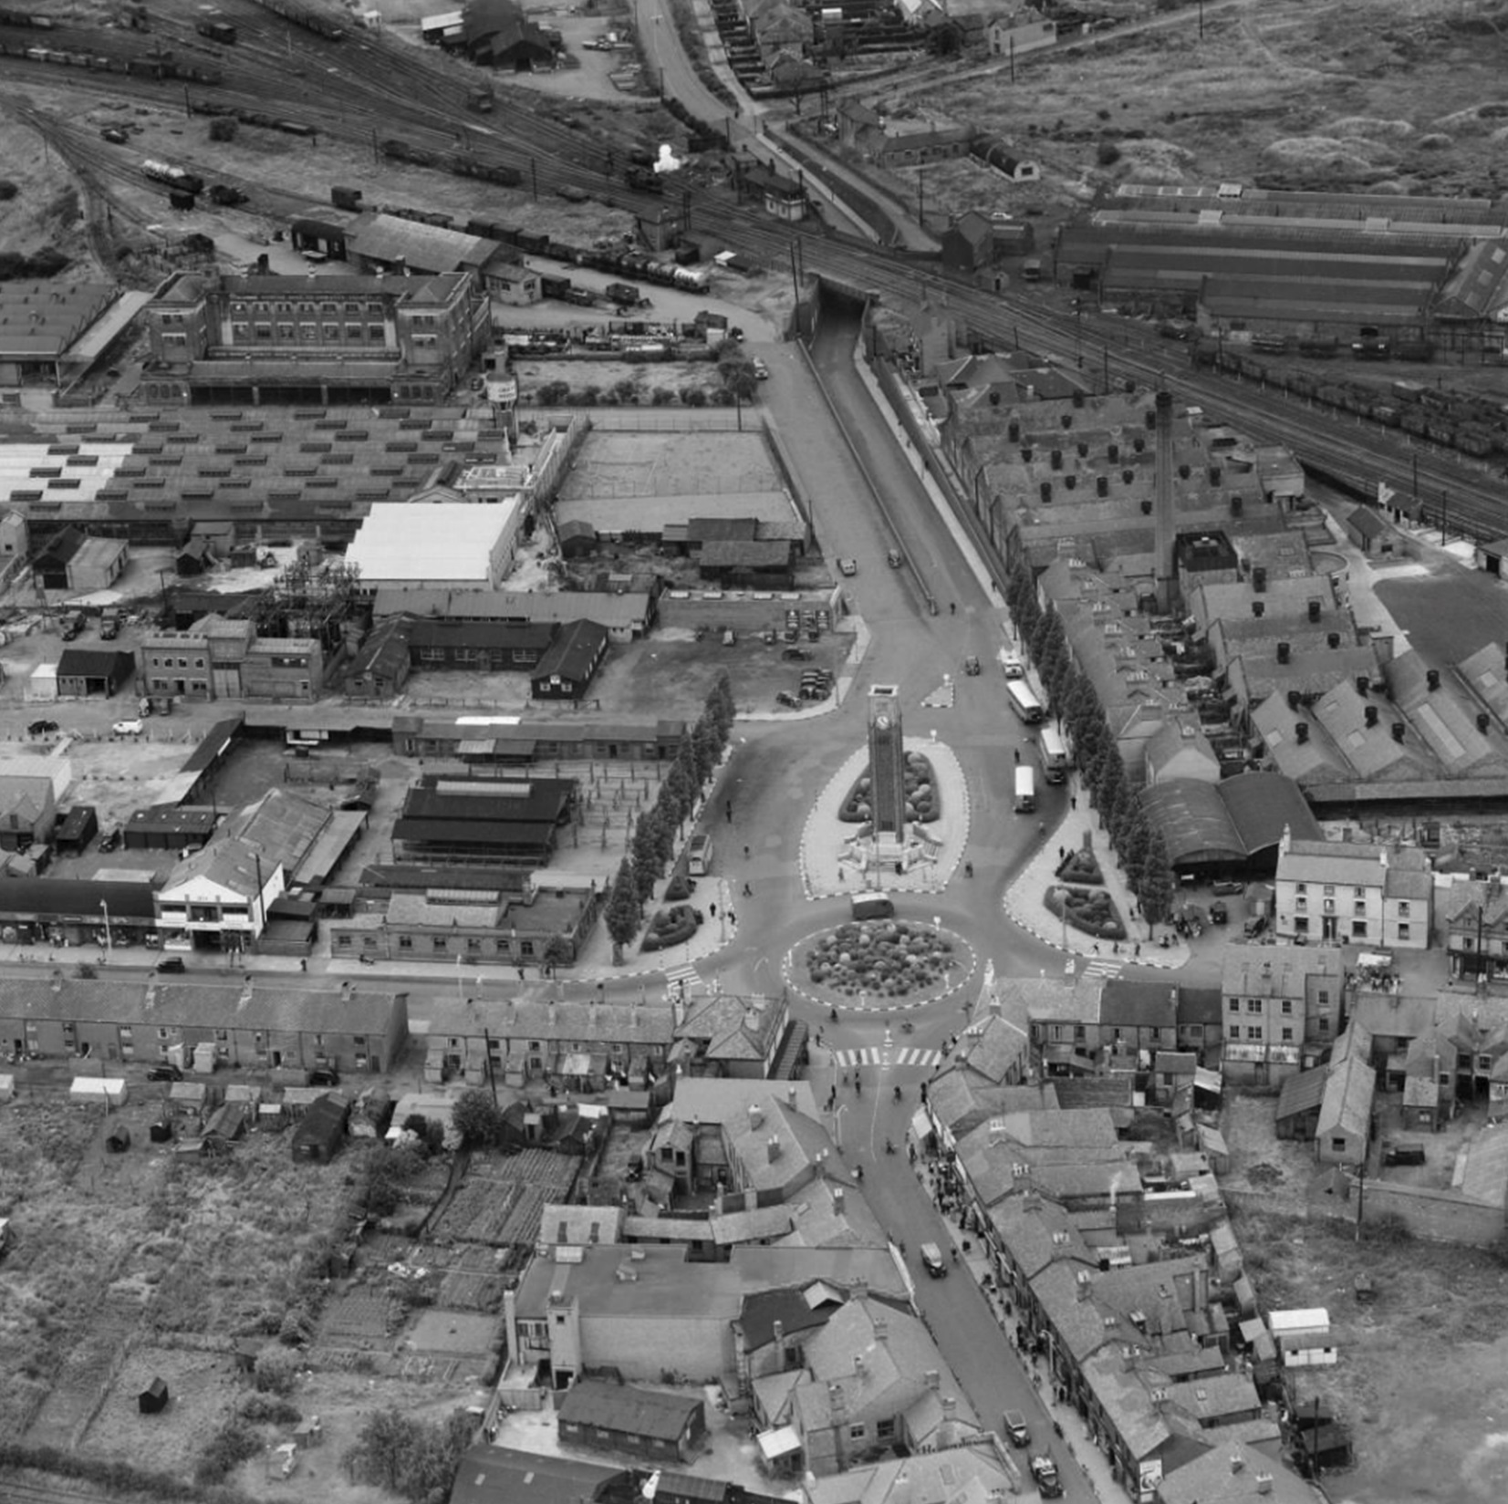
This photograph shows Memorial Square and the surrounding area in 1952.
How has the area changed since the photograph was taken?

Slide 14
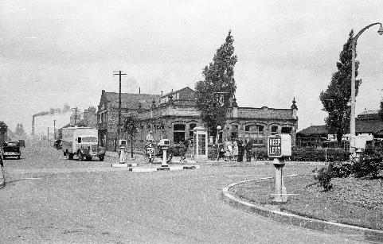
Special historic interest
The Memorial Clock Tower is classed as Grade II by Historic England which means that it is protected by the law.
It cannot be altered or demolished without permission.
Why is the Memorial Clock Tower Grade II listed?
It has historic value – it teaches us about significant past events
It is a nice design and is very tall!
The Clock Tower and Memorial Square are in the Coalville Conservation Area
Above: A view of the old Post Office taken in 1947. Memorial Square is to the right. You can just see Snibston mine in the background.

Slide 15
Image copyright
Slide 3 View taken from top of the Clock Tower; Michael Faulkner
Slide 4 Cover from the first commemorative event at the Memorial Clock Tower; Coalville Heritage Society
Slide 5 Image of clock face; Michael Faulkner
Slide 6 In the early 2000s the clock was removed for restoration and repair; Coalville Heritage Society
Slide 7 tablets to commemorate those who fell in WWI and WWII; Michael Faulkner
Slide 8 Remembrance stones to commemorate those who fell in recent conflicts installed in 2014; Michael Faulkner
Slide 9 Plan of Memorial Square; Ordnance Survey
Slide 10 Extract of the 1880s and 1920s Ordnance Survey Maps; Creative Commons Attribution-NonCommercial-ShareAlike (CC-BY-NC-SA) licence, educational use.
Slide 11 View of the Clock Tower soon after the unveiling; Coalville Heritage Society
Slide 12 A view of the ‘old’ Post Office taken in 1947. The Clock Tower roundabout is just visible on the right. The chimney at Snibston Mine can be seen belching out smoke in the distance. The photograph was taken by Simeon Stacey (local photographer); Coalville Heritage Society
Slide 13 Aerial photograph of Memorial Square and the surrounding area 1952; www.britianfromabove.org.uk © Historic England
Licenced for educational use.
Slide 14 Looking north with the roundabout in the foreground. Taken in 1947 by Simeon Stacey (local photographer); Coalville Heritage Society

Slide 16
These teacher’s slides form part of the education resources that were produced as part of the Memorial Clock Tower Project that was undertaken by North West Leicestershire District Council in 2018. The project was helped with funding from the Heritage Lottery Fund and the War Memorials Trust.
Further details of the project and downloads are available at: heritage-consultant.com/downloads
This education resource was produced by Heritage First Ltd with copywriting services provided by
Well Read.
Copyright: Heritage First Ltd 2018

